Slide 1
Evergreen Marketing Kit

Slide 2
Marketing Kit Guidelines
Leverage the assets within this tool kit to inspire MRS. SMITH’S® shoppers along the path to purchase.
Leverage retailer channels: placements in communications and tactics pre-shop (digital and circular).
Leverage tool kit assets to have a consistent look and feel at all touch points during the campaign.
CIRCULAR ASSETS
Assets will include editable files along with MRS. SMITH’S® pack-shot images.
Leverage assets for placement in-ad and update with correct product mix, description and pricing.
DIGITAL BANNERS
Assets will include editable files.
Leverage assets for placement on retail websites or ad exchange and update the CTA based on click-through destination.
Click through: all banner ads should link to MRS. SMITH’S® product information on the retailer’s site or digital incentives (if available).
SOCIAL MEDIA
Assets will include digital-ready images that can be used on retailer’s Facebook, Twitter and Instagram channels.
Social post copy will be provided. Retailer can adjust copy to align with their social voice/tone and can highlight special offers or deals.
Click through/link: social posts should link to MRS. SMITH’S® product information on the retailer’s site or digital incentives (if available).

Slide 3
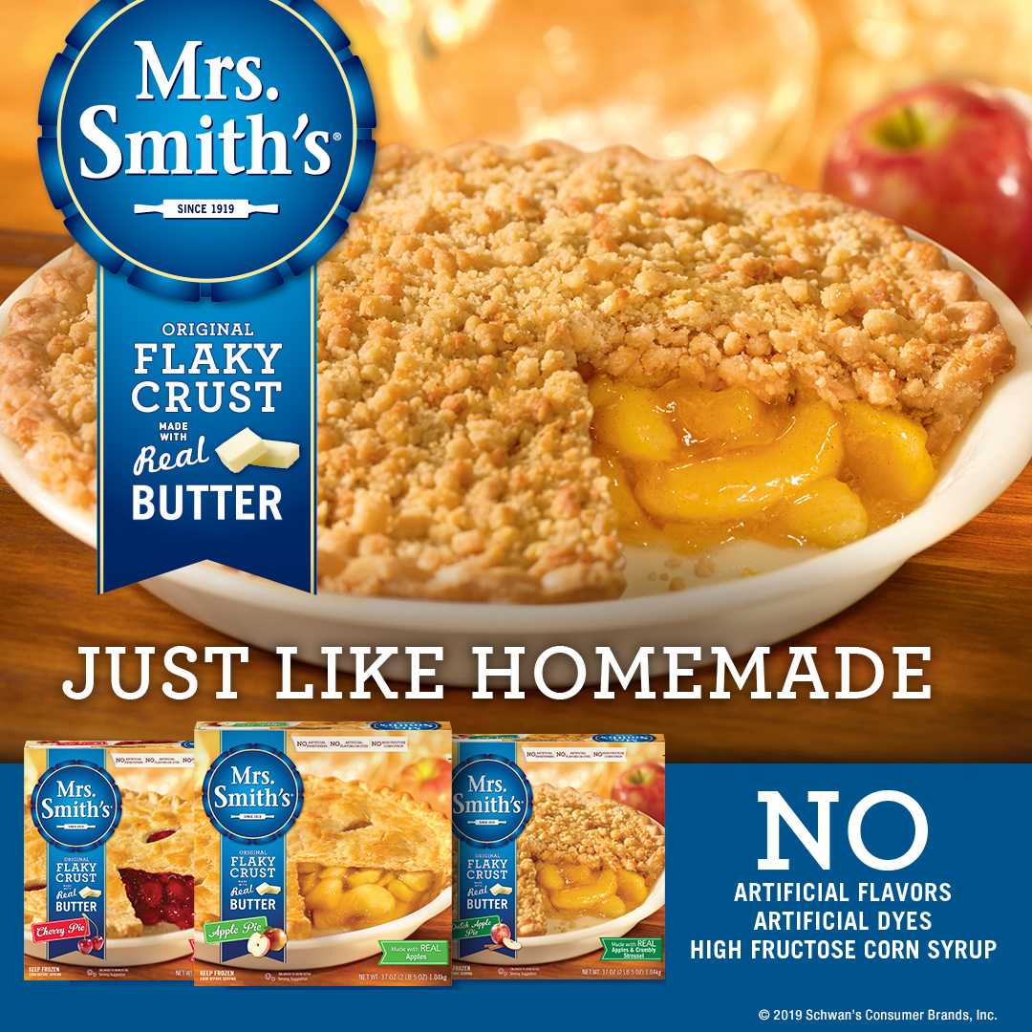
Evergreen Marketing Kit Deliverables
DOWNLOAD ASSETS: CLICK HERE
HAVE QUESTIONS OR NEED ADDITIONAL SUPPORT?
CONTACT: Kaitlin Milkovich
Kaitlinmilkovich@upshotmail.com
DELIVERABLES
CIRCULAR AD LAYOUTS
3" W x 3" H and 10" W x 3" H
DIGITAL
Standard banners: 300 x 250, 728 x 90, 160 x 600 and 320 x 50
SOCIAL MEDIA
Facebook News Feedback: 1,200 x 628 pixels
Instagram: 1,080 x 1,080 pixels
Twitter: 800 x 320 pixels
+ post copy options for social channels

Slide 4
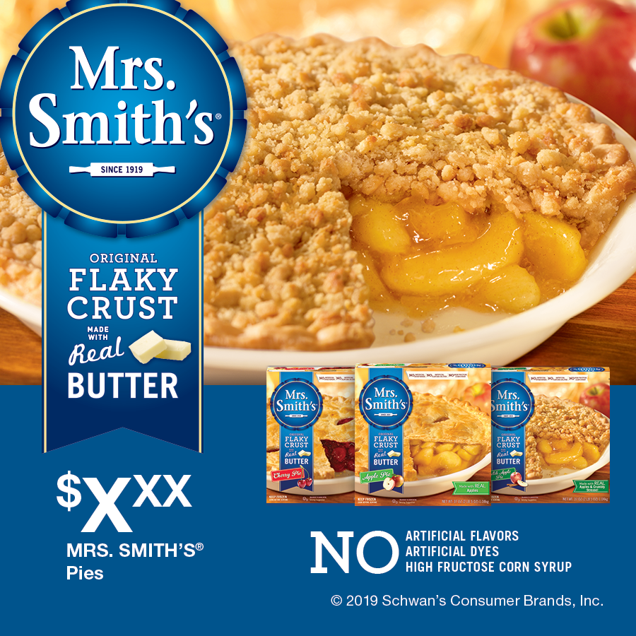
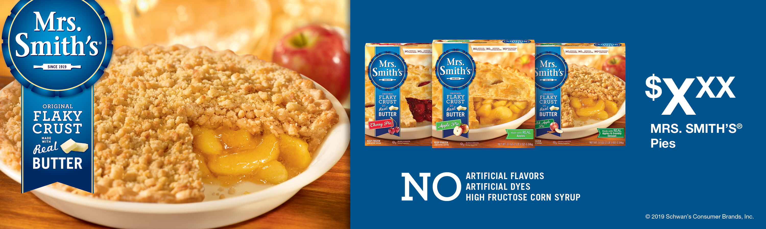
Circular Ads
Circular Ad Layouts
3" W x 3" H
10" W x 3" H
3" W x 3" H
10" W x 3" H

Slide 5
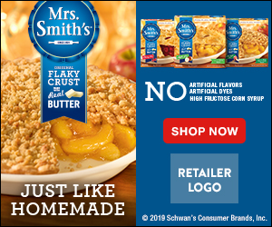
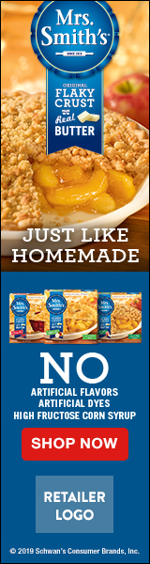


Digital Banners
Digital Banners
300 x 250
728 x 90
160 x 600
328 x 50
300 x 250
728 x 90
320 x 50
160 x 600

Slide 6
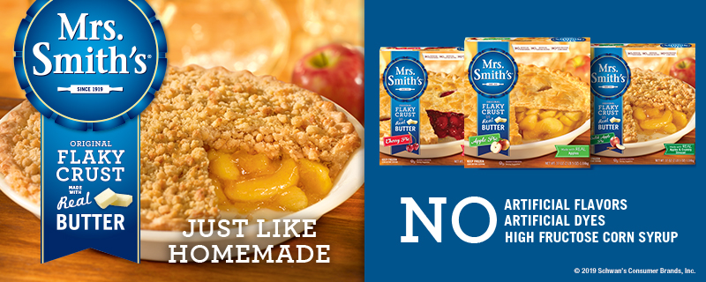
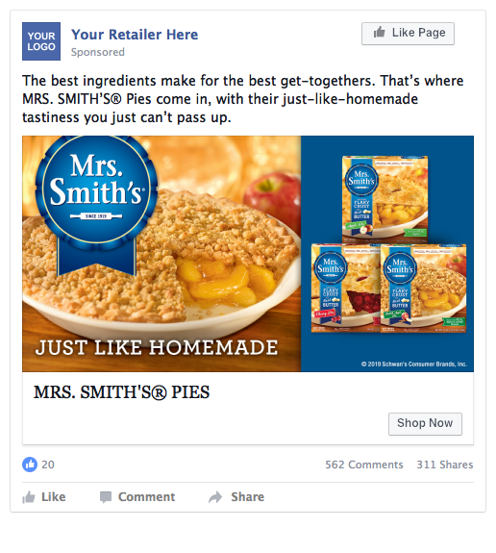
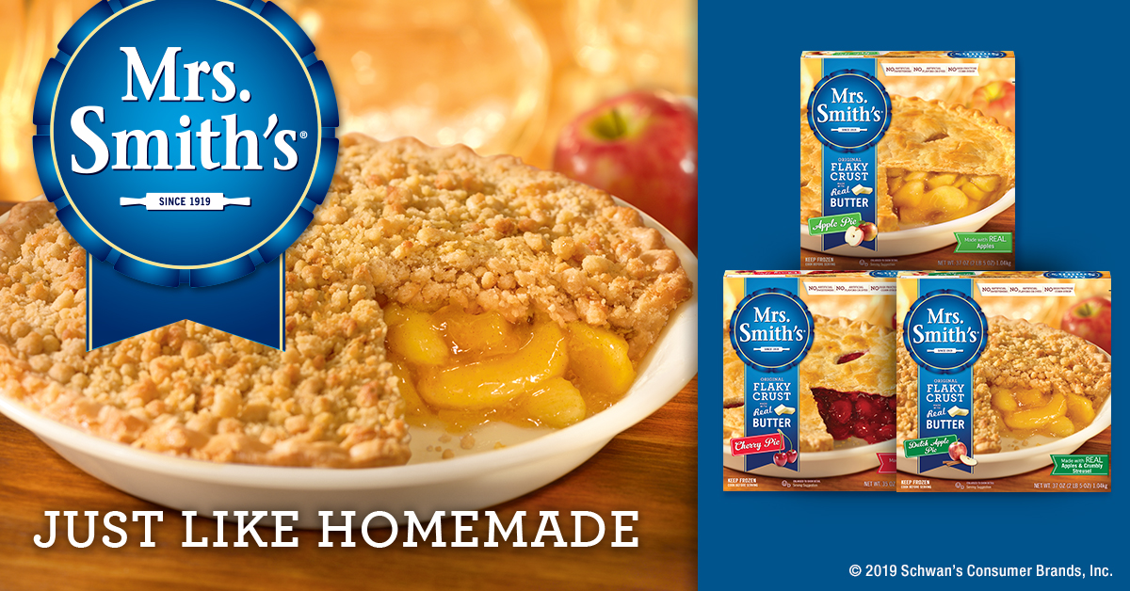
Social Media
Social Layouts
Facebook newsfeed ad 1,200 x 628
Instagram 1,080 x 1,080
Twitter 800 x 320
Twitter
800 x 320
Instagram
1080 x 1080
Facebook
1200 x 628
Social Post Copy Options
The best ingredients make for the best get-togethers. That’s where MRS. SMITH’S® Pies come in, with their just-like-homemade tastiness you just can’t pass up.
Make family and friends feel welcome one bite at a time with a variety of delicious pies from MRS. SMITH’S®.
With tasty, flakey crusts and a variety of flavorful options including Apple, Cherry and Dutch Apple, MRS. SMITH’S® Pies have exactly what your family is looking for.

