Slide 1
EDWARDS SUMMER
TOOLKIT
2020

Slide 2
TOOL KIT GUIDELINES
Leverage the assets within this tool kit to delight and inspire Edwards shoppers all along the path to purchase.
Work with retail partners to secure placements in communications and tactics pre-shop (digital and circular).
Leverage tool kit assets to have a consistent look and feel at all touch points during the campaign.
CIRCULAR ASSETS
Assets will include editable files along with Edwards pack-shot images.
Retailers can leverage assets for placement in-ad and can update with correct product mix, description and pricing.
DIGITAL BANNERS
Assets will include editable files. Retailers can add their logo to the banner.
Retailers can leverage assets for placement on their retail websites or ad exchange and can update the CTA based on click-through destination.
Click through: all banner ads should link to Edwards product information on the retailer’s site or digital coupons (if available).
SOCIAL MEDIA
Assets will include digital-ready images that can be used on the retailer’s Facebook, Twitter and Instagram channels.
Social post copy will be provided. Retailers can adjust copy to align with their social voice/tone and can highlight special offers or deals available on EdwardsDesserts.com or the retailer’s site.
Click through/link: social posts should link to Edwards product information on the retailer’s site or digital coupons (if available).

Slide 3
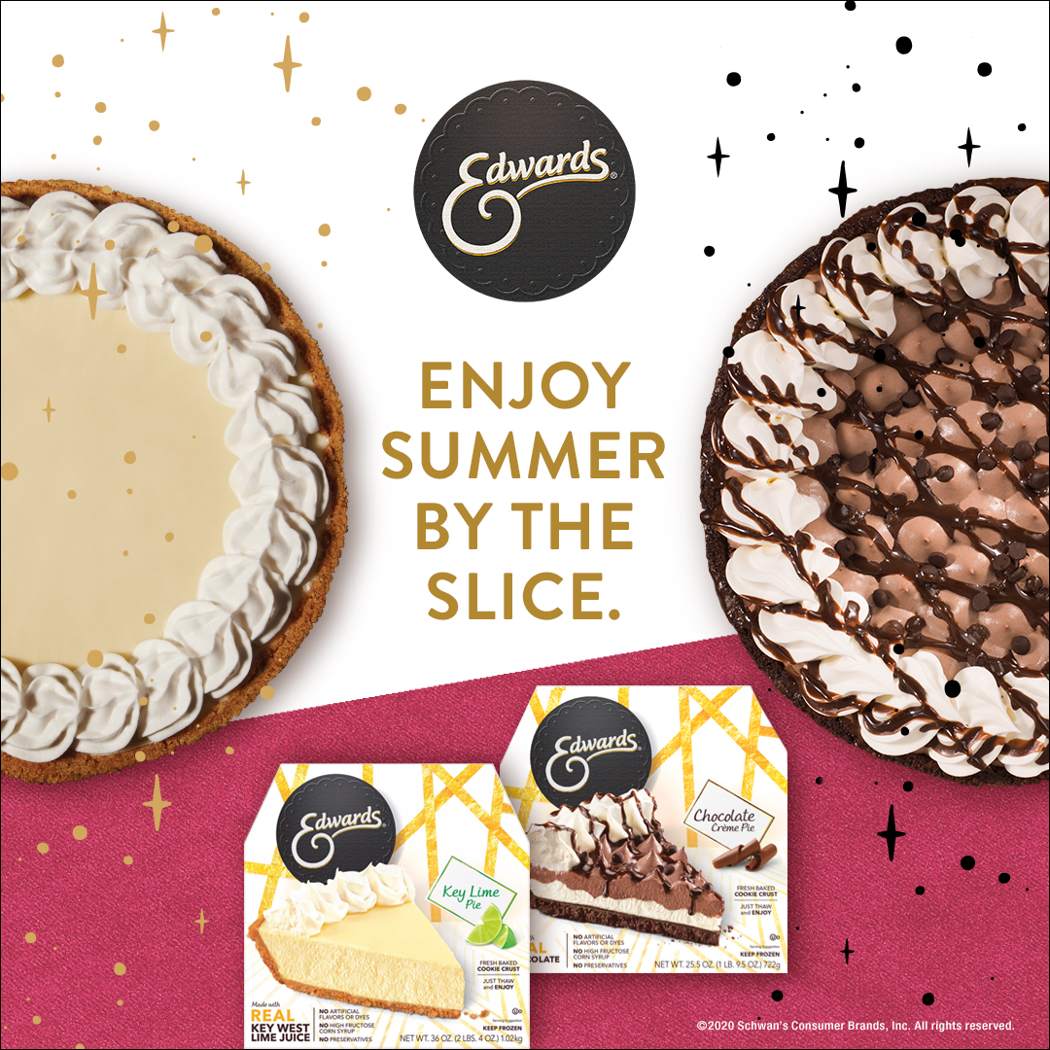
EDWARDS SUMMER TOOL KIT
DOWNLOADABLE ASSETS & PRINTED CLING
DOWNLOAD ASSETS: CLICK HERE
QUESTIONS OR NEED ADDITIONAL SUPPORT?
CONTACT: Christa Bundt
Christa.Bundt@Schwans.com
DELIVERABLES
Circular Ad Layouts
3" W x 3" H and 10" W x 3" H
Digital
Standard banners: 300 x 250, 728 x 90, 160 x 600 and 320 x 50
Social Media
Facebook newsfeed ad: 1,200 x 628 pixels
Instagram: 1,080 x 1,080 pixels
Twitter: 800 x 320 pixels
+ post copy for each platform
Printed Cling
6" W x 9" H (available to be placed by service representative)

Slide 4
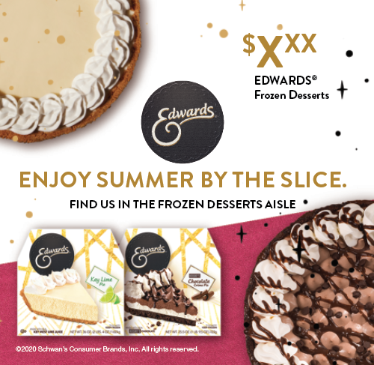
CIRCULAR ADS
CIRCULAR AD LAYOUTS
3" W x 3" H
10" W x 3" H
3" W X 10" H
10" W X 3" H

Slide 5
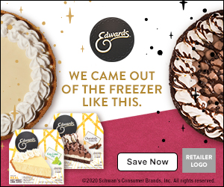
DIGITAL ADS
DIGITAL AD LAYOUTS
300 x 250
728 x 90
160 x 600
320 x 50
300 x 250
320 x 50
728 x 90 SHOWN AT 75%
160 x 600 SHOWN AT 75%

Slide 6
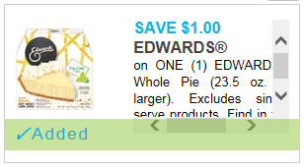
DIGITAL AD - ADDITIONAL DETAILS
CLICK-THRU OPTIONS
Save Now or Earn Cash Back CTA Options:
Link to a Digital Coupon offer if available (CTA: Save Now)
Link to the Ibotta offer (within the app if available (CTA: Earn Cash Back)
Learn More or Shop Now CTA Options:
Link to the product page on the retailer website for product information (CTA: Learn More)
Link to the product page on retailer website to add to cart if this capability exists (CTA: Shop Now)
ALT HEADLINES
DITCH THE MELTY MESS. STICK WITH SUMMER’S BEST.
YOUR HEART SHOULD MELT. YOUR DESSERT SHOULDN’T.
DELICIOUS ANY WAY YOU SLICE IT.
*National offers will be communicated as they are confirmed.

Slide 7
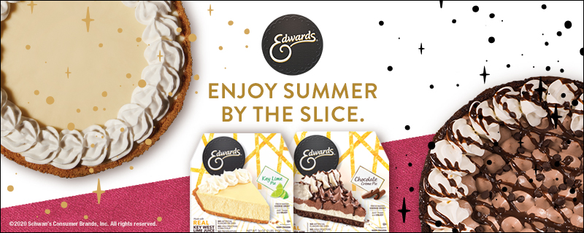
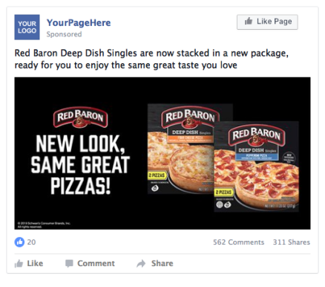
SOCIAL MEDIA
SOCIAL LAYOUTS
Facebook newsfeed ad 1200 x 628
Instagram 1080 x 1080
Twitter 800 x 320
Ditch the melty mess of ice cream—Edwards Frozen Desserts are the simple solution to any summertime event in need of a delicious dessert. #ElevateYourDessert #SliceofSummer
INSTAGRAM
TWITTER
SOCIAL POST COPY OPTIONS
Ditch the melty mess of ice cream—Edwards Frozen Desserts are the simple solution to any summertime event in need of a delicious dessert. #ElevateYourDessert #SliceofSummer
Serve up some summer love with Edwards Frozen Desserts—the delicious thaw-and-serve desserts that won’t leave a melty mess. #ElevateYourDessert #SliceofSummer
Keep your summertime livin’ easy with Edwards Frozen Desserts—the delicious thaw-and-serve that won’t leave a melty mess. #ElevateYourDessert #SliceofSummer
FACEBOOK

