Slide 1
Freschetta Core Evergreen Marketing Kit

Slide 2
Core Evergreen Marketing Kit Guidelines
Leverage the assets within this toolkit to delight and inspire Freschetta shoppers all along the path to purchase.
Work with retail partners to secure placements in communications and tactics pre-shop (digital and circular)
Leverage toolkit assets to have a consistent look and feel at all touchpoints during the campaign.
Circular Assets
Assets will include editable files along with Freschetta pack shot images.
Retailers can leverage assets for placement in-ad and can update with correct product mix, description and pricing.
Digital Banners
Assets will includes editable files.
Retailers can leverage assets for placement on their retail websites or ad exchange and can update the CTA based on click through destination.
Banner ads should link to Freschetta product information on the retailer’s site or digital coupons (if available).
Social Media
Assets will include digital-ready images the can be used on the retailer’s Facebook, Twitter and Instagram channels.
Social post copy will be provided. Retailer’s can adjust copy to align with their social voice/tone and can highlight specials offers or deals available on Freschetta.
Social posts should link to Freschetta product information on the retailer’s site or digital coupons (if available).

Slide 3
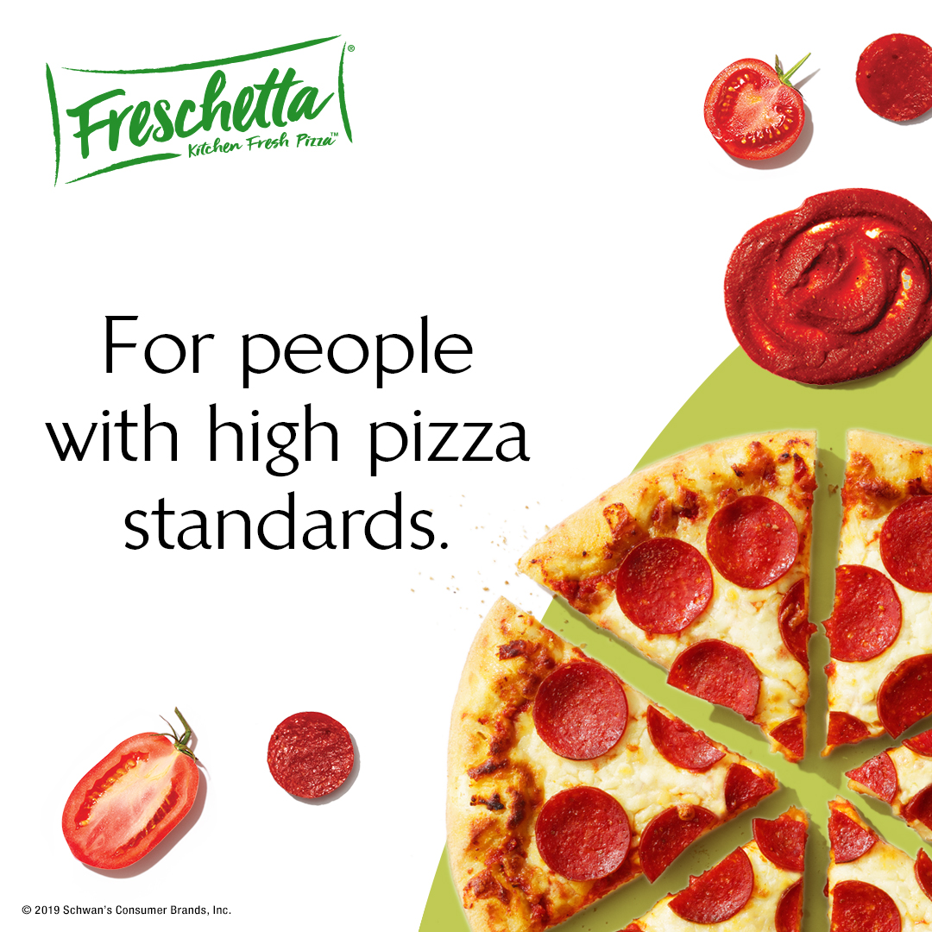
Core Evergreen Marketing Kit Downloadable Assets
HAVE QUESTIONS OR NEED ADDITIONAL SUPPORT?
CONTACT: Christa Bundt
Christa.Bundt@Schwans.com
DELIVERABLES
Circular Ad Layouts
3” W x 3” H and 10” W x 3” H
Digital
Standard Banners: 300x250, 728x90, 160x600 and 320x50
Social Media
Facebook Newsfeed Ad: 1,200 x 628 pixels
Instagram: 1,080 x 1,080 pixels
Twitter: 800 x 320 pixels
+ Post copy options
DOWNLOAD ASSETS: CLICK HERE

Slide 4
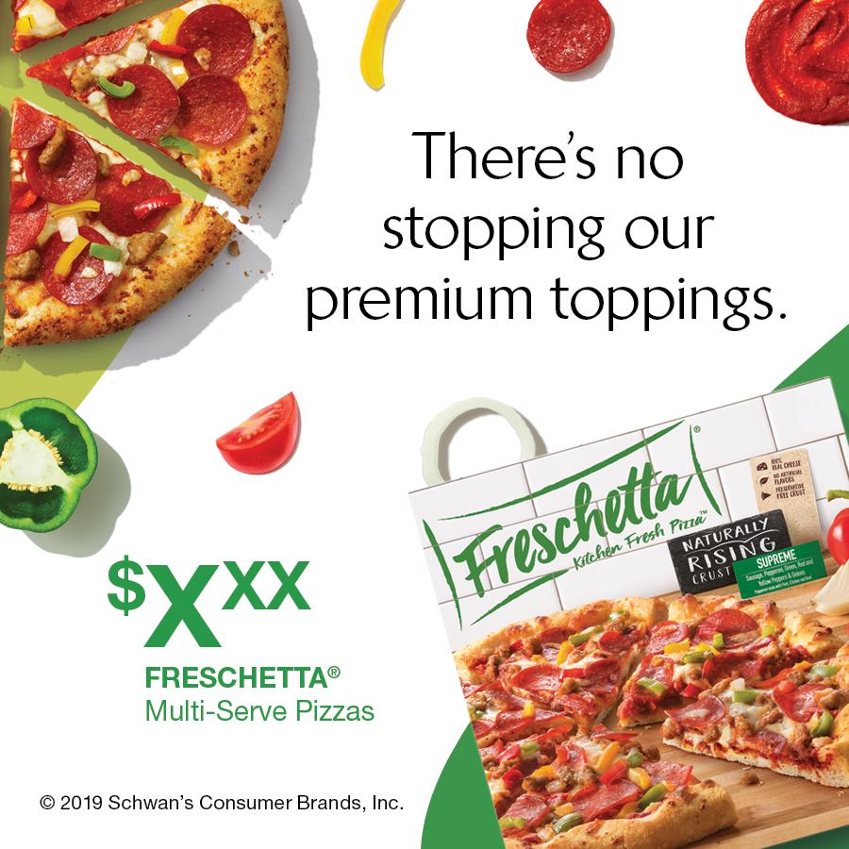
Circular Assets
Circular Ad Layouts
3" W x 3" H
10" W x 3" H
3”X3”
10”X3”

Slide 5
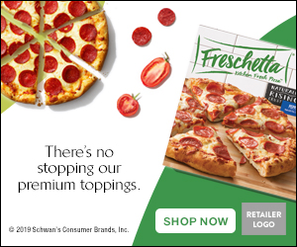
Digital Assets
Digital Banners
300 x 250
728 x 90
168 x 600
328 x 50
300X250
728X90
320X50
160X600

Slide 6
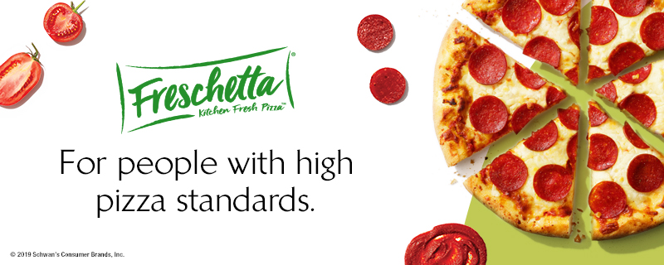
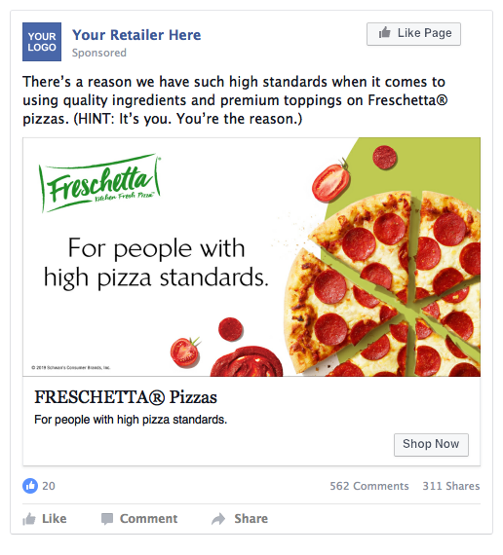
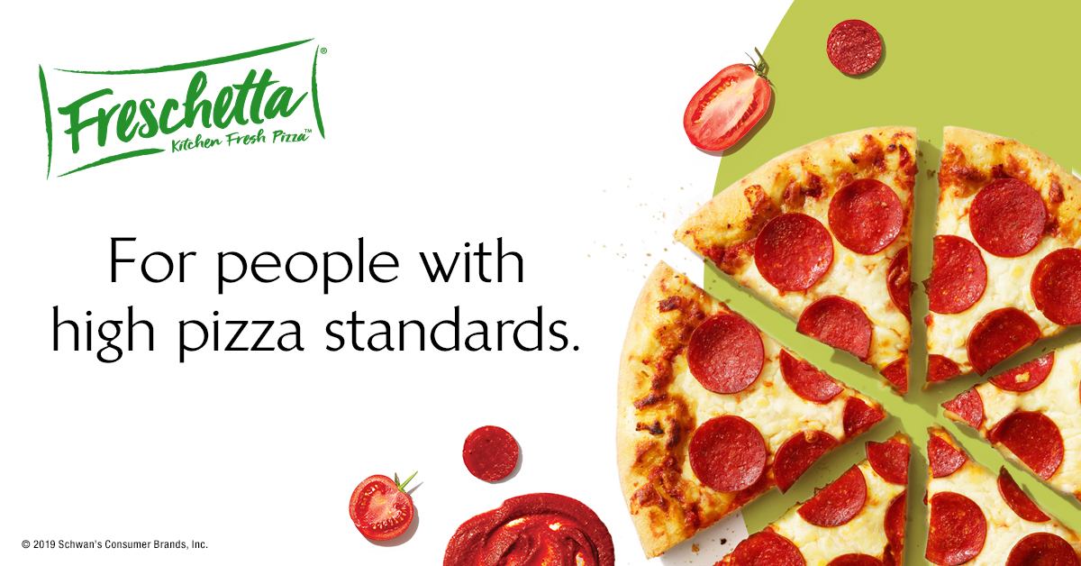
Social Media
Social Layouts
Facebook newsfeed ad 1200 x 628
Instagram 1080 x 1080
Twitter 800 x 320
Twitter 800 x 320
Instagram 1080 x 1080
Facebook 1200 x 628
Social Post Copy Options
There’s a reason we have such high standards when it comes to using quality ingredients and premium toppings on Freschetta pizzas. (HINT: It’s you. You’re the reason.)
We go the extra mile in making pizza with quality you can taste. Because we know that’s how you’d make it.
Pizza is always good. But why settle for “good” when you can have GREAT pizza with highest-quality ingredients and premium toppings? That’s where Freschetta comes in.

