Slide 1
Thin Crust Marketing Kit
2021

Slide 2
Marketing Kit Guidelines
Leverage the assets within this marketing kit to delight and inspire FRESCHETTA® shoppers along the path to purchase.
Leverage retailer channels: placements in communications and tactics pre-shop (digital and circular).
Leverage marketing kit assets to have a consistent look and feel at all touch points during the campaign.
CIRCULAR ASSETS
Assets will include editable files along with FRESCHETTA® pack-shot images.
Retailers can leverage assets for placement in-ad and can update with correct product mix, description and pricing.
DIGITAL BANNERS
Assets will include editable files. Retailers can add their logo to the banner.
Retailers can leverage assets for placement on retail websites or ad exchange and can update the CTA based on click-through destination.
Banner ads should link to FRESCHETTA® product information on the retailer’s site or digital coupons (if available).
SOCIAL MEDIA
Assets will include digital-ready images that can be used on retailer’s Facebook, Twitter and Instagram channels.
Social post copy will be provided. Retailers can adjust copy to align with their social voice/tone and can highlight special offers or deals available on the retailer’s site.
Social posts should link to FRESCHETTA® product information on retailer’s site or digital incentives (if available).

Slide 3
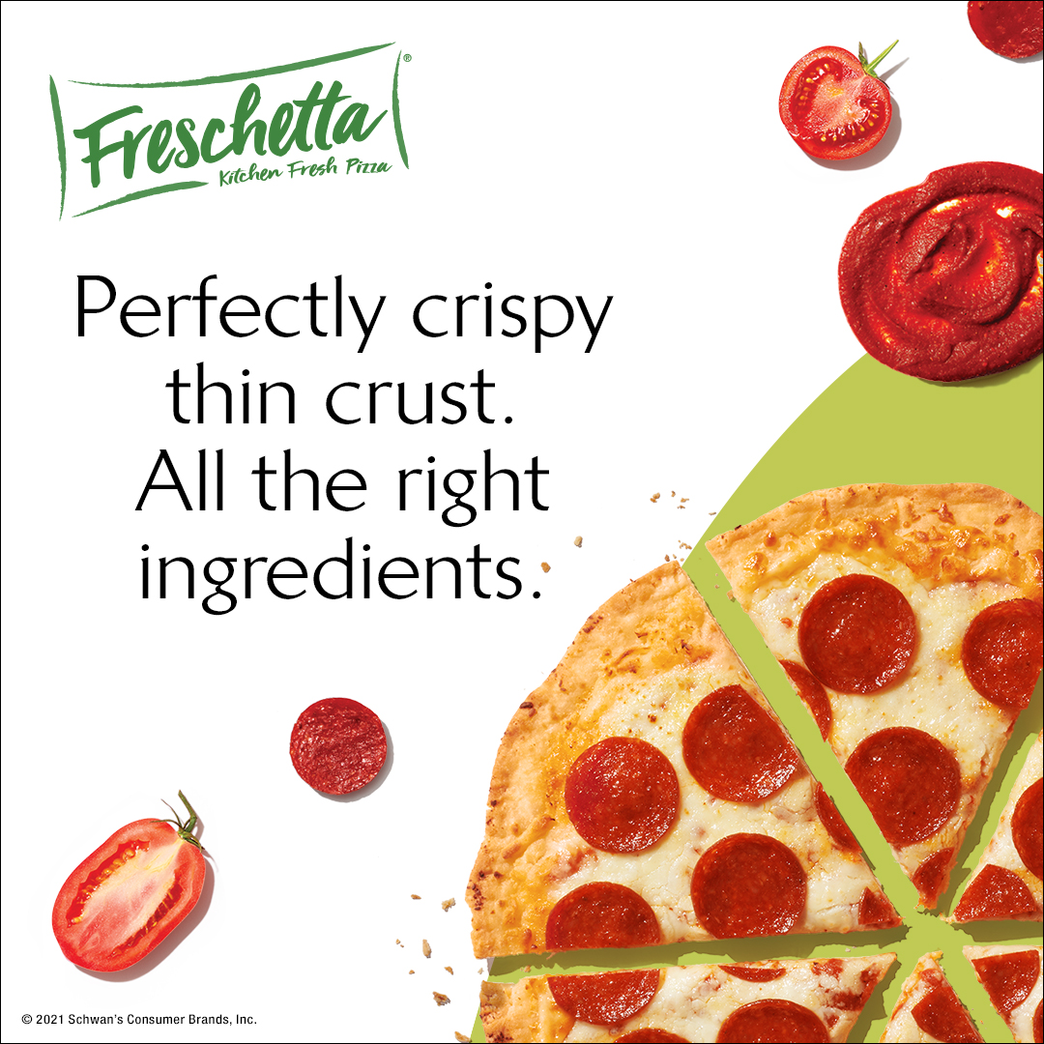
Thin Crust Marketing Kit
DOWNLOADABLE ASSETS & PRINTED CLINGS
DOWNLOAD ASSETS: CLICK HERE
HAVE QUESTIONS OR NEED ADDITIONAL SUPPORT?
CONTACT: Christa Bundt
Christa.Bundt@Schwans.com
DELIVERABLES
Circular Ad Layouts
3" W x 3" H and 10" W x 3" H
Digital
Standard banners: 300 x 250, 728 x 90, 160 x 600 and 320 x 50
Social Media
Facebook newsfeed ad: 1,200 x 628 pixels
Instagram: 1,080 x 1,080 pixels
Twitter: 800 x 320 pixels
+ post copy options

Slide 4
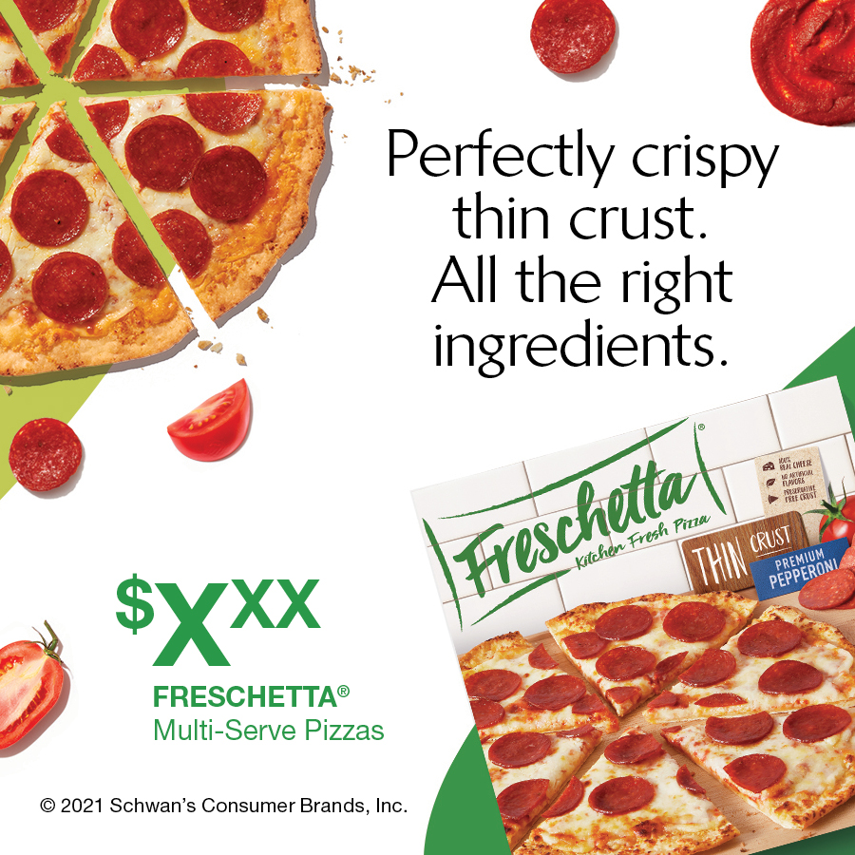
Circular Ads
CIRCULAR AD LAYOUTS
3" W x 3" H
10" W x 3" H
3" W X 10" H
10" W X 3" H

Slide 5
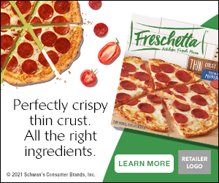
Digital Banners
DIGITAL AD LAYOUTS
300 x 250
728 x 90
160 x 600
320 x 50
300 x 250
320 x 50
728 x 90 SHOWN AT 75%
160 x 600 SHOWN AT 75%

Slide 6
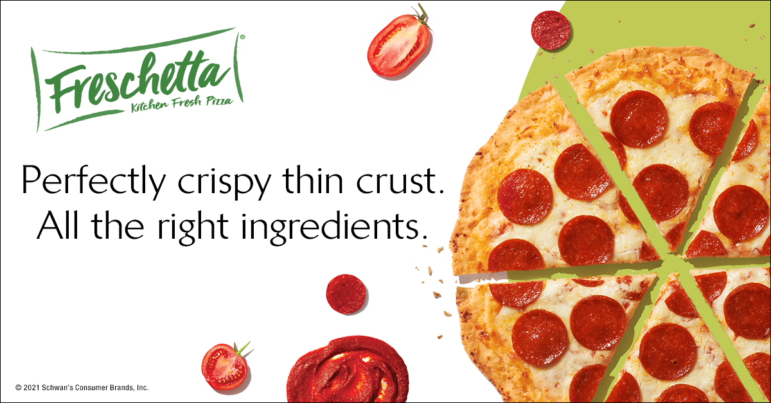
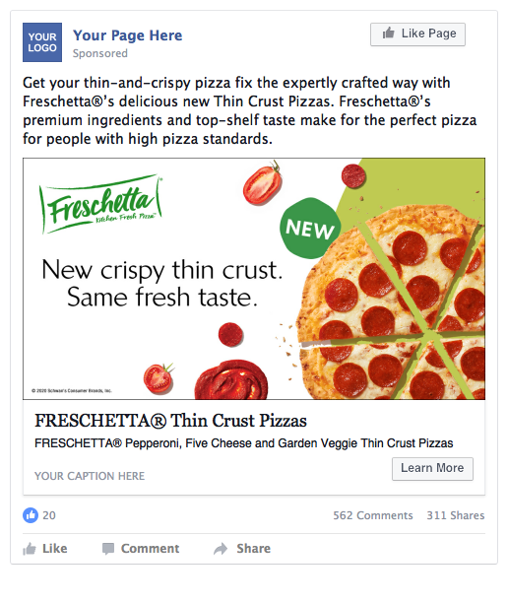
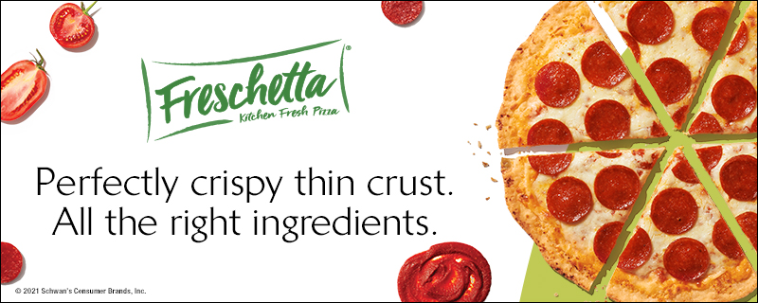
Social Media
SOCIAL LAYOUTS
Facebook newsfeed ad: 1,200 x 628 Instagram: 1,080 x 1,080 Twitter: 800 x 320
FACEBOOK
INSTAGRAM
TWITTER
SOCIAL POST COPY OPTIONS
Get your thin-and-crispy pizza fix the expertly crafted way with Freschetta®’s delicious Thin Crust Pizzas. Freschetta®’s premium ingredients and top-shelf taste make for the perfect pizza for people with high pizza standards.
Going with Freschetta®’s delicious Thin Crust Pizza is an easy choice. The hard part is picking between Pepperoni, Five Cheese or Garden Veggie. With premium ingredients and irresistible crispiness, we know it’s tough!
Freschetta®’s delicious Thin Crust Pizzas are made for people with high pizza standards because we know you expect the best. That’s why we use premium meats and real cheeses in all of our pizza varieties. Try one today and see for yourself!
FACEBOOK
Call to Action Options: Shop Now, Save Now, Learn More

Slide 7
Digital Copy and CTA Options
ALT DIGITAL CTA OPTIONS
ALT COPY OPTIONS
Learn More, Shop Now or Save Now CTA Options:
Link to the product page on the retailer's website for product information (CTA: Learn More).
Link to the product page on the retailer's website to add to cart if they have this capability (CTA: Shop Now).
Link to a coupon or offer (CTA: Save Now).
Alt headline options for Circulars, Banners, and Social Creative:
“Delightfully crispy thin crust. All the right ingredients.”
300 x 250 LEARN MORE
300 x 250 SAVE NOW
300 x 250 SHOP NOW

