Slide 1
PIZZA MELTS MARKETING KIT

Slide 2
MARKETING KIT GUIDELINES
Leverage the assets within this marketing kit to delight and inspire RED BARON® shoppers along the path to purchase.
Leverage retailer channels: placements in communications and tactics pre-shop (digital and circular).
Leverage marketing kit assets to have a consistent look and feel at all touch points during the campaign.
CIRCULAR ASSETS
Assets will include editable files along with RED BARON® pack-shot images.
Leverage assets for placement in-ad and can update with correct product mix, description and pricing.
DIGITAL BANNERS
Assets will include editable files. Retailers can add their logo to the banner.
Leverage assets for placement on retail websites or ad exchange and can update the CTA based on click-through destination.
Click-through: all banner ads should link to RED BARON® product information on the retailer’s site or digital incentives (if available).
SOCIAL MEDIA
Assets will include digital-ready images that can be used on retailer’s Facebook, Twitter and Instagram channels.
Social post copy will be provided. Retailers can adjust copy to align with their social voice/tone and can highlight special offers or deals available on RedBaron.com or the retailer’s site.
Click-through/link: social posts should link to RED BARON® product information on retailer’s site or digital incentives (if available).

Slide 3
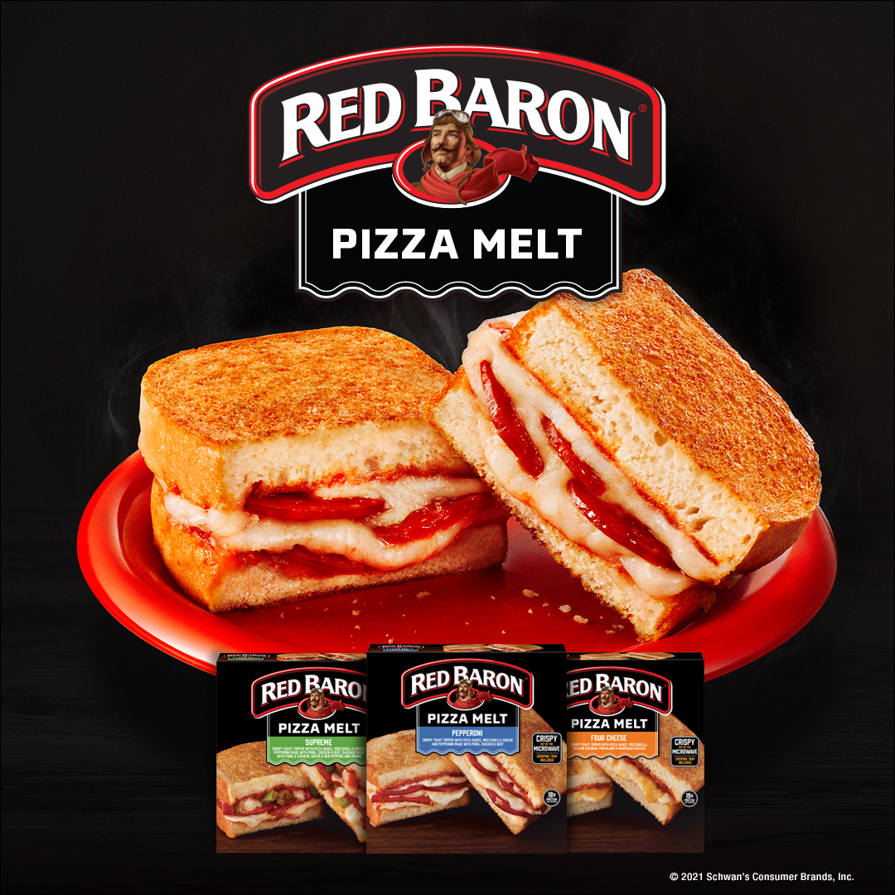
PIZZA MELT ASSETS AVAILABLE
DELIVERABLES
Circular Ad Layouts
3" W x 3" H and 10" W x 3" H
Digital
Standard banners:
300 x 250, 728 x 90, 160 x 600 and 320 x 50
Social Media
Facebook newsfeed ad: 1,200 x 628 pixels
Instagram: 1,080 x 1,080 pixels
Twitter: 800 x 320 pixels
+ post copy options
DOWNLOAD ASSETS: CLICK HERE
HAVE QUESTIONS OR NEED ADDITIONAL SUPPORT?
Contact: Christa Bundt Christa.Bundt@Schwans.com

Slide 4
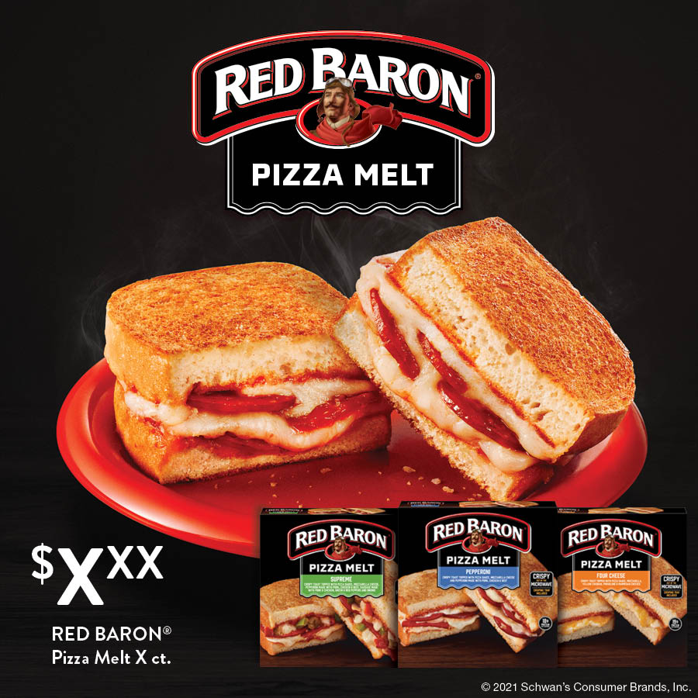
CIRCULAR ADS
DELIVERABLES
Circular Ad Layouts
3" W x 3" H and 10" W x 3" H
PLEASE NOTE: PACKAGED PHOTOSHOP FILES INCLUDE ALT SKU HERO IMAGES.
Alt Headline:
THE CRISP YOU CRAVE RIGHT OUT OF THE MICROWAVE
3" W X 3" H
10" W X 3" H

Slide 5
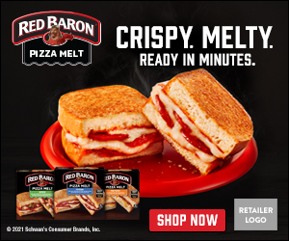
DIGITAL BANNERS
300 x 250 728 x 90 160 x 600 320 x 50
Alt CTAs:
PLEASE NOTE: LAYERED PHOTOSHOP FILES FOR EACH SIZE CONTAIN CTAs (SHOP NOW, SAVE NOW AND LEARN MORE) THAT CAN BE SWAPPED OUT.
Alt Headline:
THE CRISP YOU CRAVE RIGHT OUT OF THE MICROWAVE
300 x 250
320 x 50
728 x 90
160 x 600

Slide 6
DIGITAL CTA OPTIONS
Learn More, Shop Now or Save Now CTA Options:
Link to the product page on the retailer’s website for product information (CTA: Learn More).
Link to the product page on the retailer’s website to add to cart if this capability is available (CTA: Shop Now).
Link to a coupon or offer (CTA: Save Now).
300 x 250 SHOP NOW
300 x 250 SAVE NOW
300 x 250 LEARN MORE

Slide 7
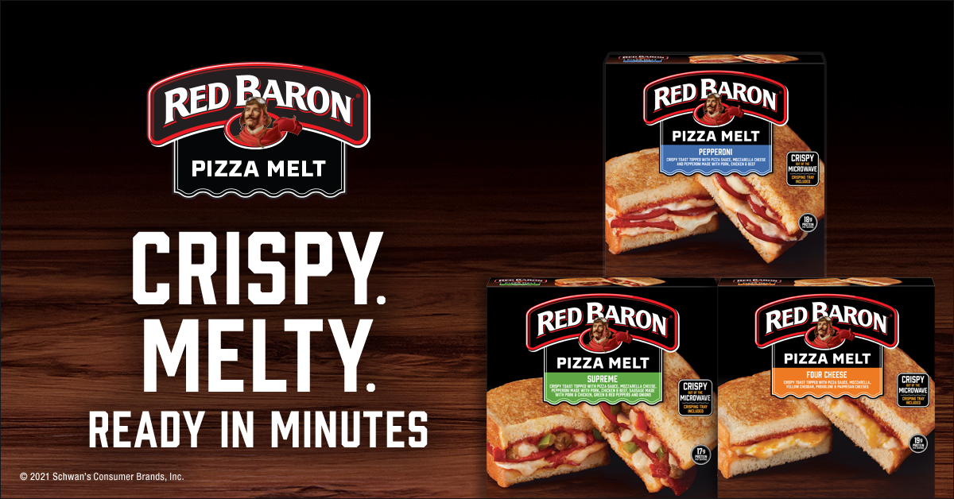
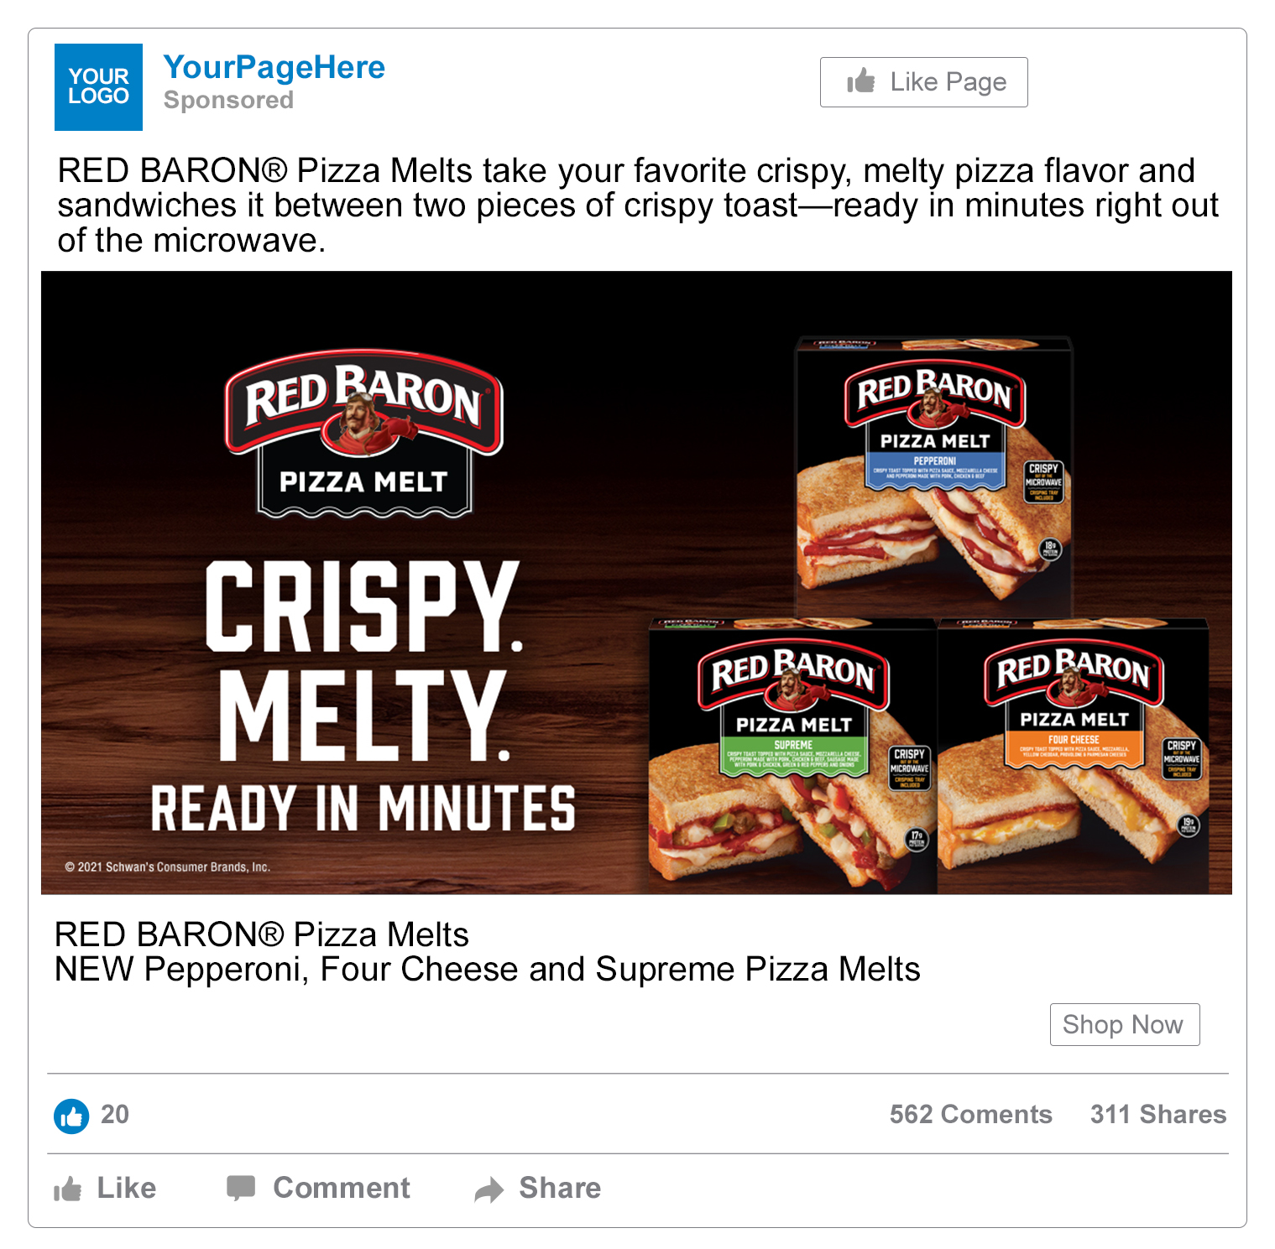
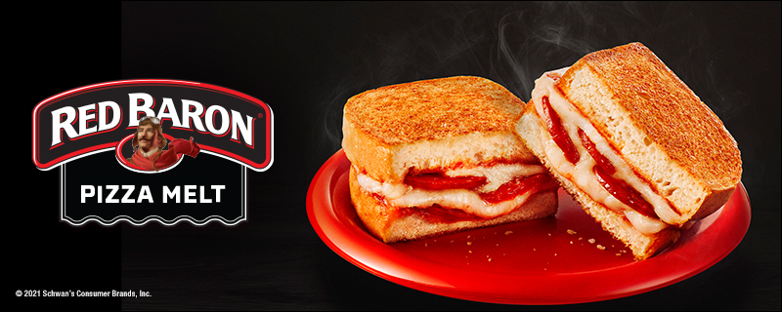
SOCIAL MEDIA
Facebook newsfeed ad: 1,200 x 628 Instagram: 1,080 x 1,080 Twitter: 800 x 320
PLEASE NOTE: LAYERED PHOTOSHOP FILES FOR EACH SIZE CONTAIN LAYERS FOR PACKS & HERO MELT IMAGE THAT CAN BE SWAPPED OUT.
FACEBOOK
INSTAGRAM
TWITTER
SOCIAL POST COPY OPTIONS
RED BARON® Pizza Melts take your favorite crispy, melty pizza flavor and sandwiches it between two pieces of crispy toast—ready in just three minutes right out of the microwave.
The microwave is your mealtime solution with delicious new RED BARON® Pizza Melts. Crispy, melty pizza flavor is yours in minutes with these mouth-watering new microwavable pizza snack sandwiches, only from RED BARON®.
FACEBOOK

