Slide 1
BIBIGO
Marketing Kit
2021

Slide 2
Marketing Kit Guidelines
Leverage the assets within this marketing kit to delight and inspire BIBIGO® shoppers along the path to purchase.
Leverage retailer channels: placements in communications and tactics pre-shop (digital and circular).
Leverage marketing kit assets to have a consistent look and feel at all touch points during the campaign.
CIRCULAR ASSETS
Assets will include editable files along with BIBIGO® pack-shot images.
Retailers can leverage assets for placement in-ad and can update with correct product mix, description and pricing.
DIGITAL BANNERS
Assets will include editable files. Retailers can add their logo to the banner.
Retailers can leverage assets for placement on retail websites or ad exchange and can update the CTA based on click-through destination.
Banner ads should link to BIBIGO® product information on the retailer’s site or digital coupons (if available).
SOCIAL MEDIA
Assets will include digital-ready images that can be used on retailer’s Facebook, Twitter and Instagram channels.
Social post copy will be provided. Retailers can adjust copy to align with their social voice/tone and can highlight special offers or deals available on the retailer’s site.
Social posts should link to BIBIGO® product information on retailer’s site or digital incentives (if available).
FREEZER CLINGS
Work with national account manager to have clings placed in stores, while supplies last.

Slide 3
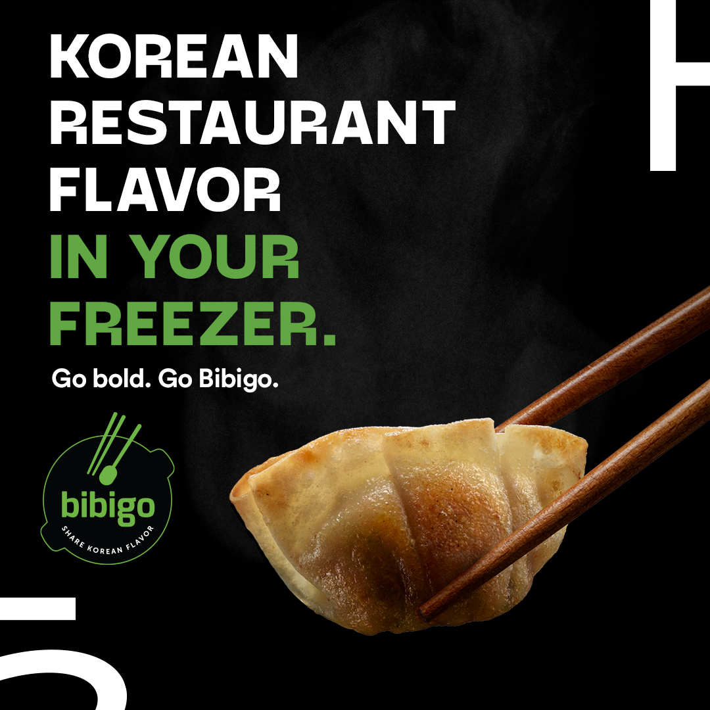
Marketing Kit
DOWNLOADABLE ASSETS
DOWNLOAD ASSETS: CLICK HERE
HAVE QUESTIONS OR NEED ADDITIONAL SUPPORT?
CONTACT: Christa Bundt
Christa.Bundt@Schwans.com
Each editable asset includes a layer for mandu, wontons or dumplings.
Circular Ad Layouts
3" W x 3" H and 10" W x 3" H
Digital
Standard banners: 300 x 250, 728 x 90, 160 x 600 and 320 x 50
Social Media
Facebook newsfeed ad: 1200 x 630 pixels
Instagram: 1080 x 1080 pixels
Twitter: 1200 x 675 pixels
+ post copy

Slide 4
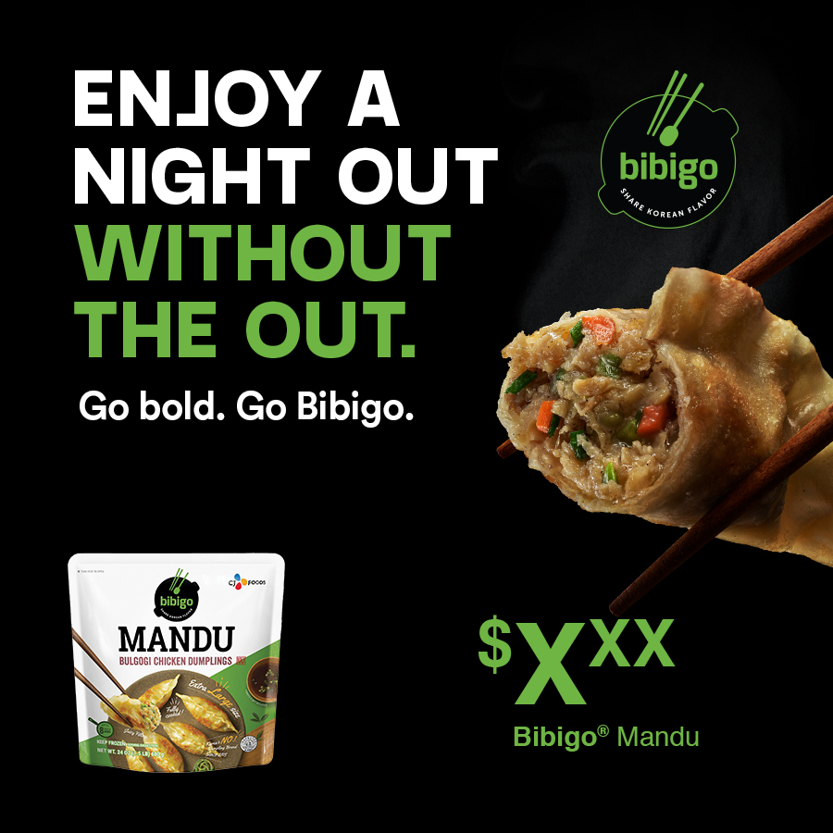
Circular Ads
CIRCULAR AD LAYOUTS
3" W x 3" H
10" W x 3" H
3" W X 10" H
Product Options: Mandu, Mini Wontons, Steamed Dumplings
10" W X 3" H

Slide 5
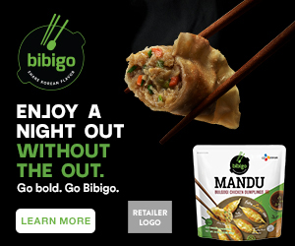
Digital Banners
DIGITAL AD LAYOUTS
300 x 250
728 x 90
160 x 600
320 x 50
300 x 250
320 x 50
728 x 90 SHOWN AT 75%
Call to Action Options: Shop Now, Save Now, Learn More
160 x 600 SHOWN AT 75%
Product Options: Mandu, Mini Wontons, Steamed Dumplings

Slide 6
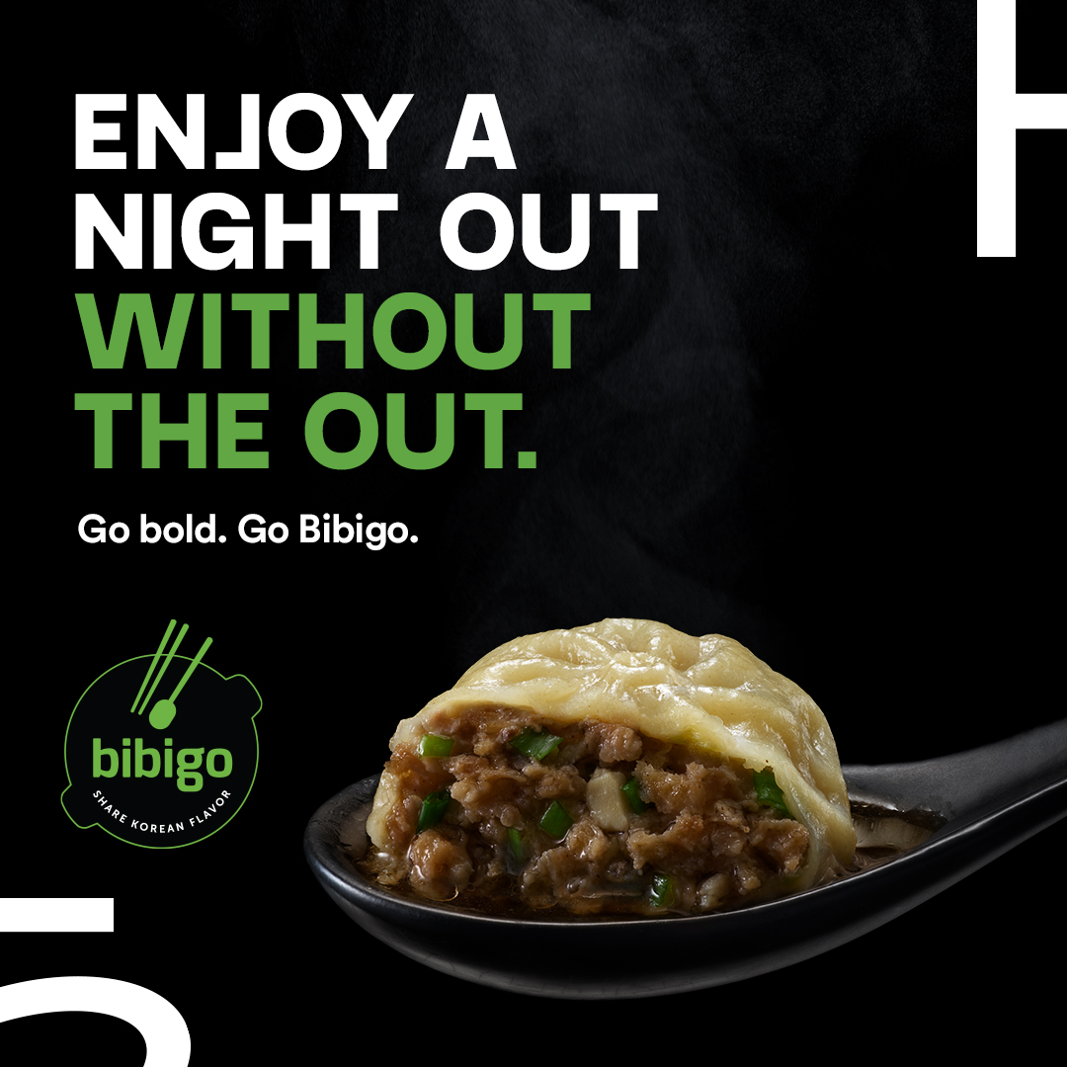
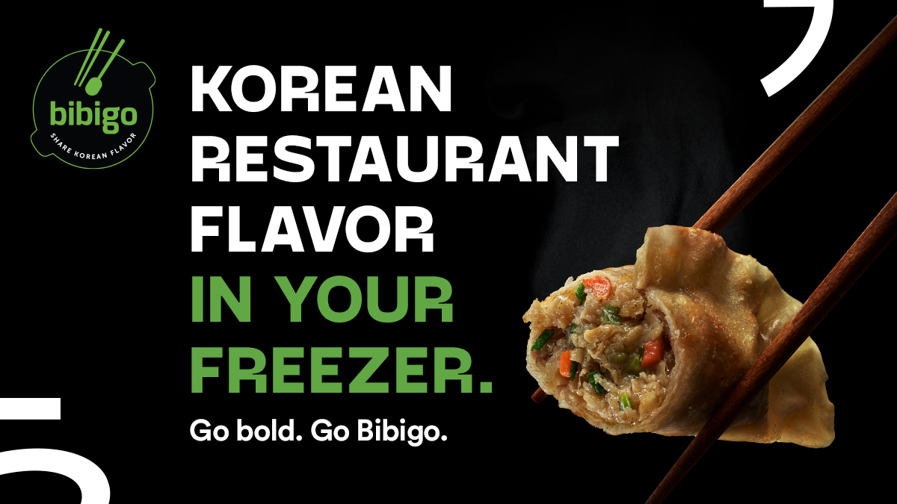
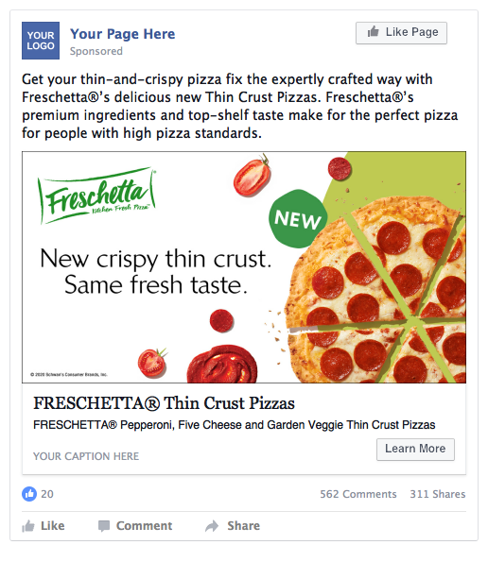
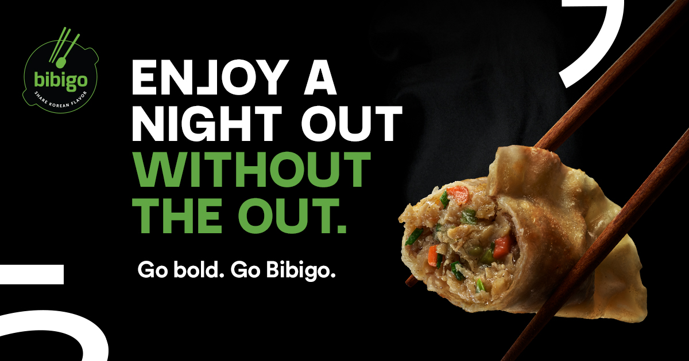
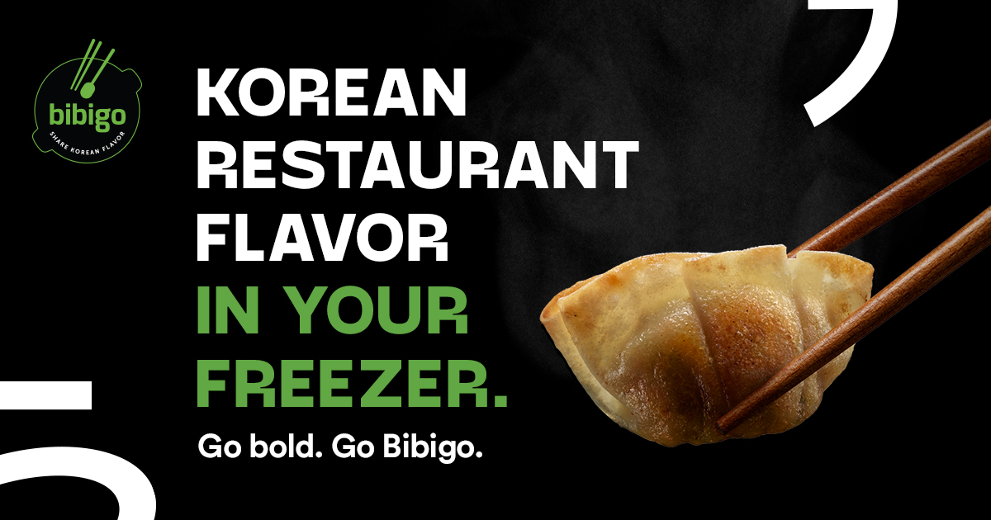
Social Media
SOCIAL LAYOUTS
Facebook newsfeed ad: 1200 x 630 Instagram: 1080 x 1080 Twitter: 1200 x 675
TWITTER
Tonight, experience the bold flavors of authentic Korean cuisine in your kitchen. Go bold. Go Bibigo.
INSTAGRAM
FACEBOOK
SOCIAL POST COPY OPTIONS
BIBIGO® Korean Cuisine.
Tonight, experience the bold flavors of authentic Korean cuisine in your kitchen 🥟🥢
Now in the freezer aisle
FACEBOOK
Call to Action Options: Shop Now, Save Now, Learn More
Product Options: Mandu, Mini Wontons, Steamed Dumplings

Slide 7
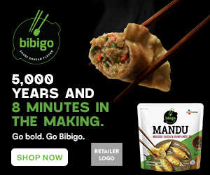
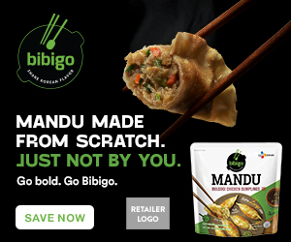
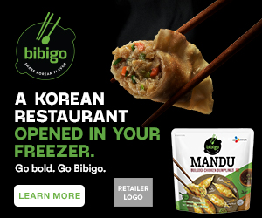
Digital Copy & CTA Options
ALT DIGITAL CTA OPTIONS
ALT COPY OPTIONS
Learn More, Shop Now or Save Now CTA Options:
Link to the product page on the retailer's website for product information (CTA: Learn More).
Link to the product page on the retailer's website to add to cart if they have this capability (CTA: Shop Now).
Link to a coupon or offer (CTA: Save Now).
Alt headline options for Circulars, Banners, and Social Creative:
Enjoy a night out without the out.
Korean restaurant flavor in your freezer.
5,000 years and 8 minutes in the making.
Mandu made from scratch. Just not by you.
A Korean restaurant opened in your freezer.
If we packed more flavor in this Mandu, we’d need another Mandu.
300 x 250 SHOP NOW
300 x 250 SAVE NOW
300 x 250 LEARN MORE

Slide 8
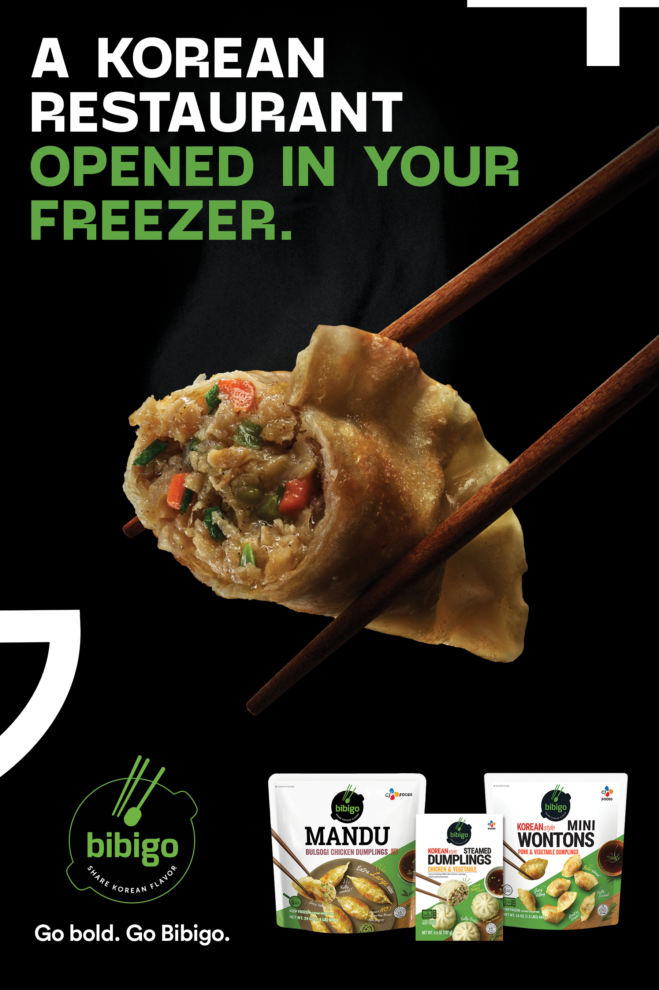
Freezer Cling
PURPOSE: Generate awareness in the freezer aisle of BIBIGO® Mandu products and how delicious they are.
Freezer clings are available to order, while supplies last.
Work with national account manager to have clings placed in stores.
Clings should only be placed in locations that do not have a clean store policy and have been approved to be put up.
6" W x 9" H

