Slide 1
BIBIGO® Meal
Marketing Kit
2021

Slide 2
Marketing Kit Guidelines
This Marketing Kit is designed with assets for field teams to leverage so they can reach shoppers across the path to purchase in the retailer’s digital channels. All assets are designed for Pre-Shop planning and have a consistent look and feel.
CIRCULAR ASSETS
Assets will include editable files along with BIBIGO® pack-shot images.
Retailers can leverage assets for placement in-ad and can update with correct product mix, description and pricing.
DIGITAL BANNERS
Assets will include editable files. Retailers can add their logo to the banner.
Retailers can leverage assets for placement on retail websites or ad exchange and can update the CTA based on click-through destination.
Banner ads should link to BIBIGO® product information on the retailer’s site or digital coupons (if available).
SOCIAL MEDIA
Assets will include digital-ready images that can be used on retailer’s Facebook, Twitter and Instagram channels.
Social post copy will be provided. Retailers can adjust copy to align with their social voice/tone and can highlight special offers or deals available on the retailer’s site.
Social posts should link to BIBIGO® product information on retailer’s site or digital incentives (if available).
FREEZER CLINGS
Work with national account manager to have clings placed in stores, while supplies last.

Slide 3
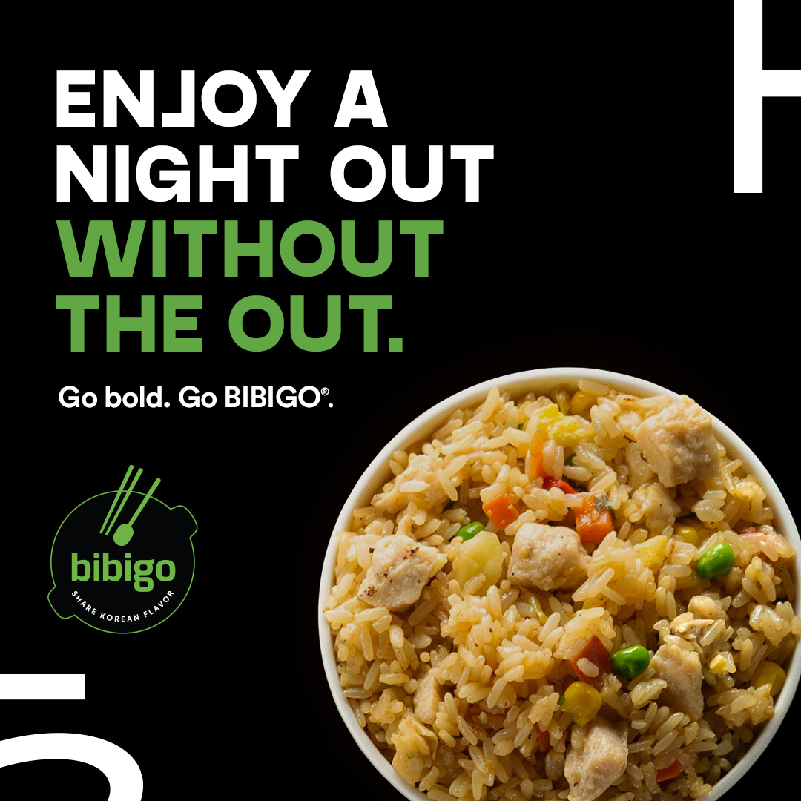
Marketing Kit
DOWNLOADABLE ASSETS
DOWNLOAD ASSETS: CLICK HERE
Each editable asset includes a layer for Fried Rice and Crunchy Chicken.
CIRCULAR ASSETS
3" W x 3" H and 10" W x 3" H
DIGITAL BANNERS
Standard banners: 300 x 250, 728 x 90, 160 x 600 and 320 x 50
SOCIAL MEDIA
Facebook newsfeed ad: 1200 x 630 pixels
Instagram: 1080 x 1080 pixels
Twitter: 1200 x 675 pixels
+ post copy
HAVE QUESTIONS OR NEED ADDITIONAL SUPPORT? CONTACT: Christa Bundt Christa.Bundt@Schwans.com

Slide 4
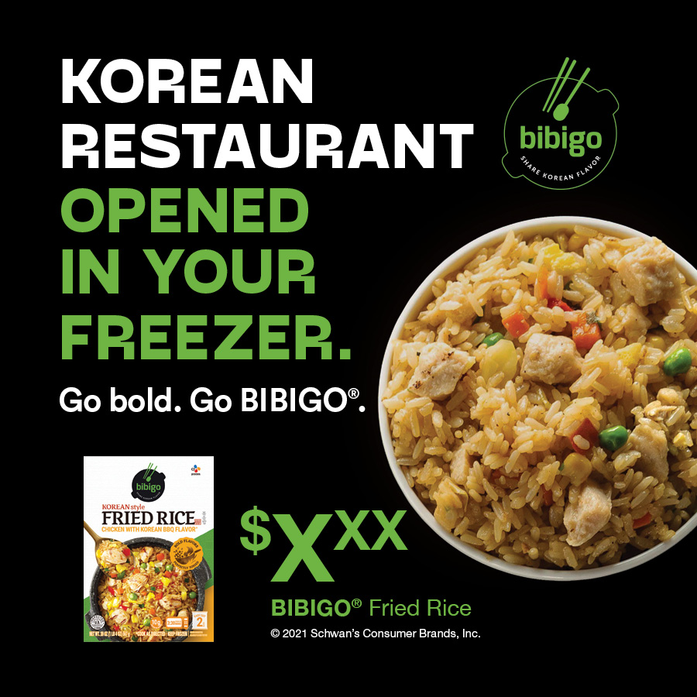
Circular Ads
CIRCULAR AD LAYOUTS
3" W x 3" H
10" W x 3" H
Product Options: Fried Rice and Crunchy Chicken

Slide 5
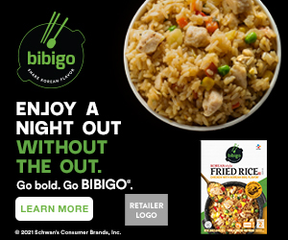
Digital Banners
DIGITAL AD LAYOUTS
300 x 250
728 x 90
160 x 600
320 x 50
300 x 250
320 x 50
Call to Action Options: Shop Now, Save Now, Learn More
728 x 90 SHOWN AT 75%
160 x 600 SHOWN AT 75%
Product Options: Fried Rice and Crunchy Chicken

Slide 6
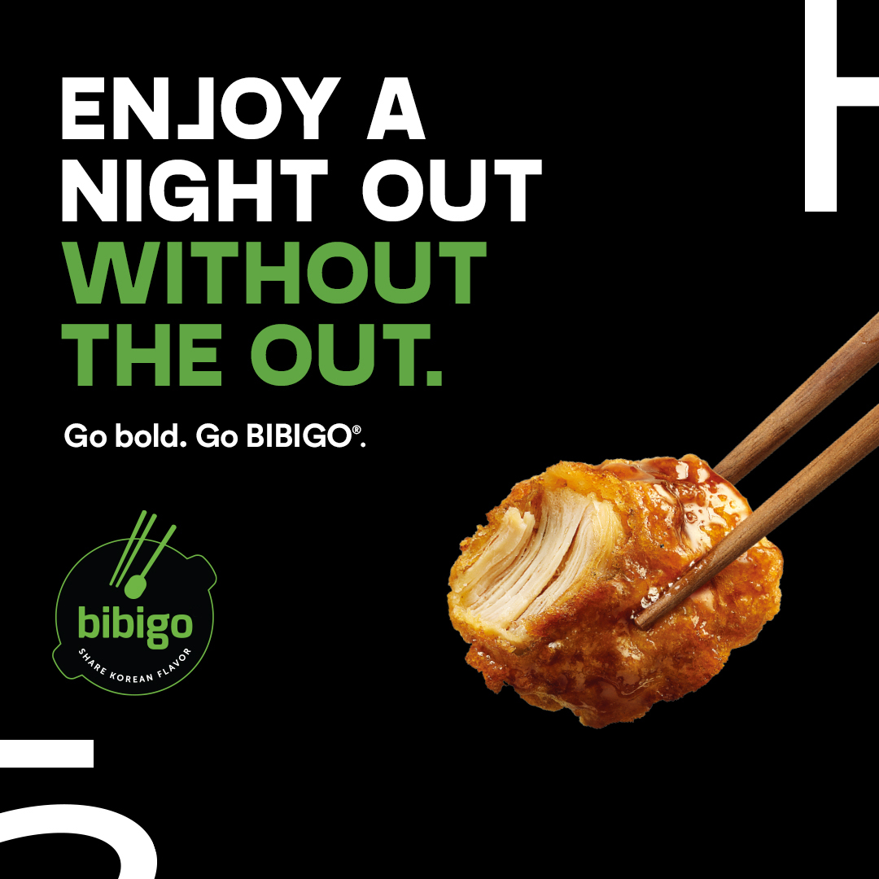
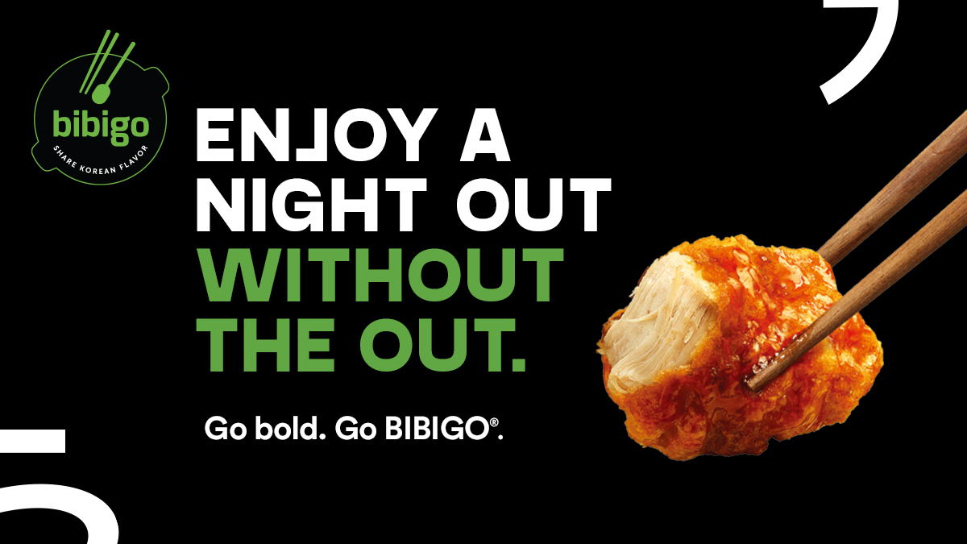
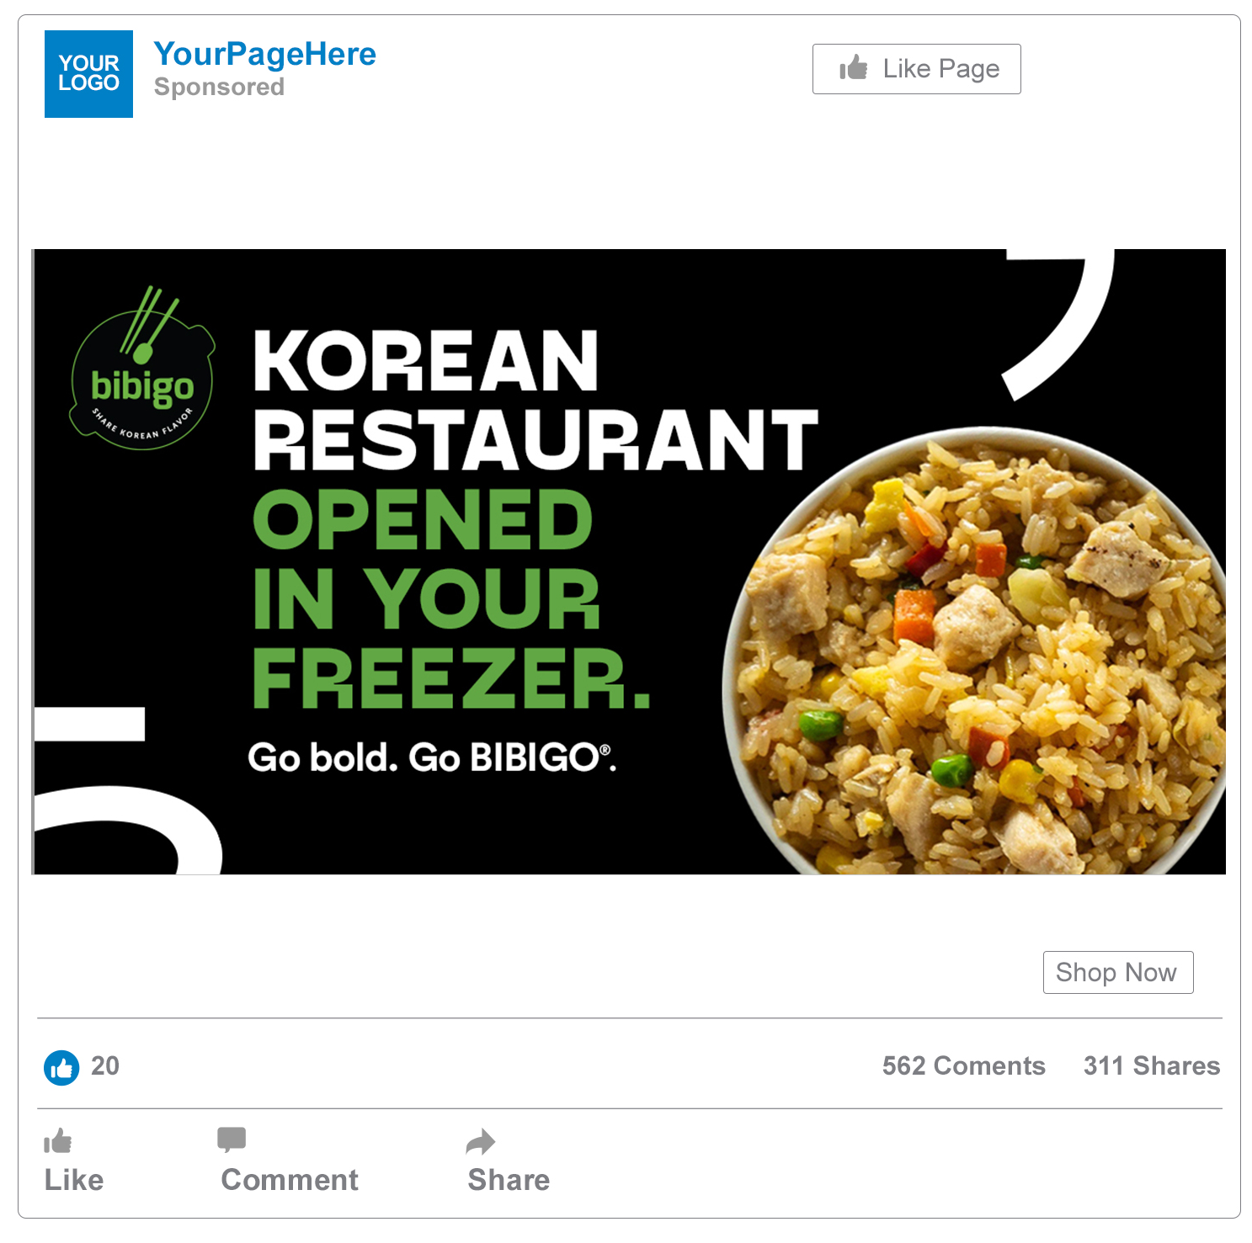
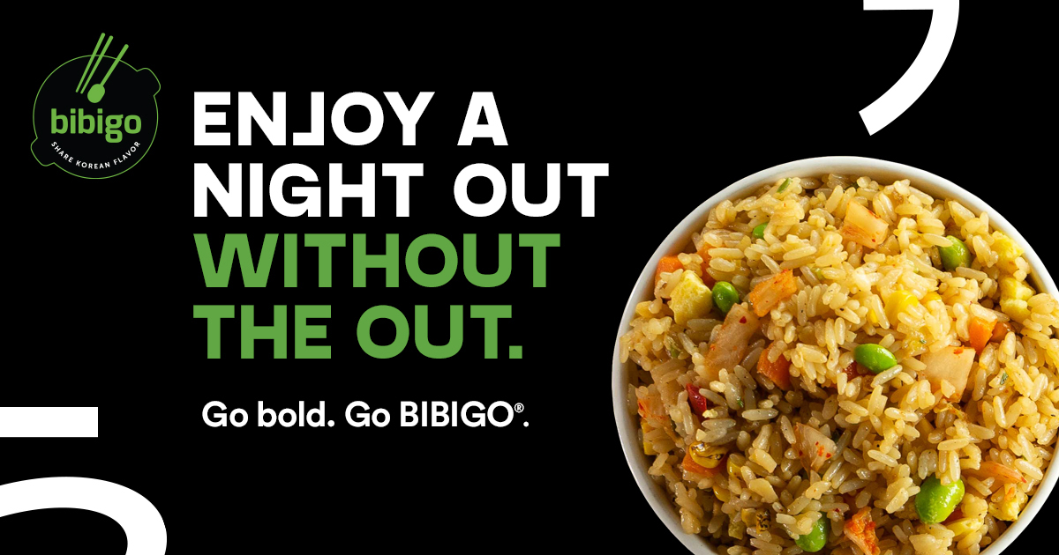
Social Media
SOCIAL LAYOUTS
Facebook newsfeed ad: 1200 x 630 Instagram: 1080 x 1080 Twitter: 1200 x 675
TWITTER
Tonight, experience the bold flavors of authentic Korean cuisine in your kitchen. Go bold. Go Bibigo.
INSTAGRAM
FACEBOOK
SOCIAL COPY OPTIONS
Tonight, experience the bold flavors of authentic Korean cuisine in your kitchen 🥟🥢
Frozen food never tasted so good. Discover BIBIGO® crunchy chicken (or fried rice) today.
Delicious authentic, Korean food can be on your table in minutes.
BIBIGO® Korean Cuisine.
Now in the freezer aisle
FACEBOOK
Product Options: Fried Rice and Crunchy Chicken

Slide 7
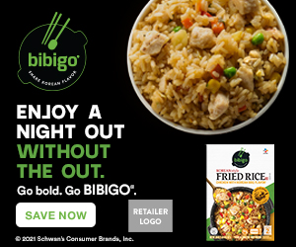
Digital Copy & CTA Options
ALT DIGITAL CTA OPTIONS
CTA Options:
Learn More: Link to the product page on the retailer's website for product information.
Shop Now: Link to the product page on the retailer's website to add to cart if they have this capability.
Save Now: Link to a coupon or offer.
ALT COPY OPTIONS
Alt headline options:
Enjoy a night out without the out.
Korean restaurant opened in your freezer.
300 x 250 SHOP NOW
300 x 250 SAVE NOW
300 x 250 LEARN MORE

