Slide 1

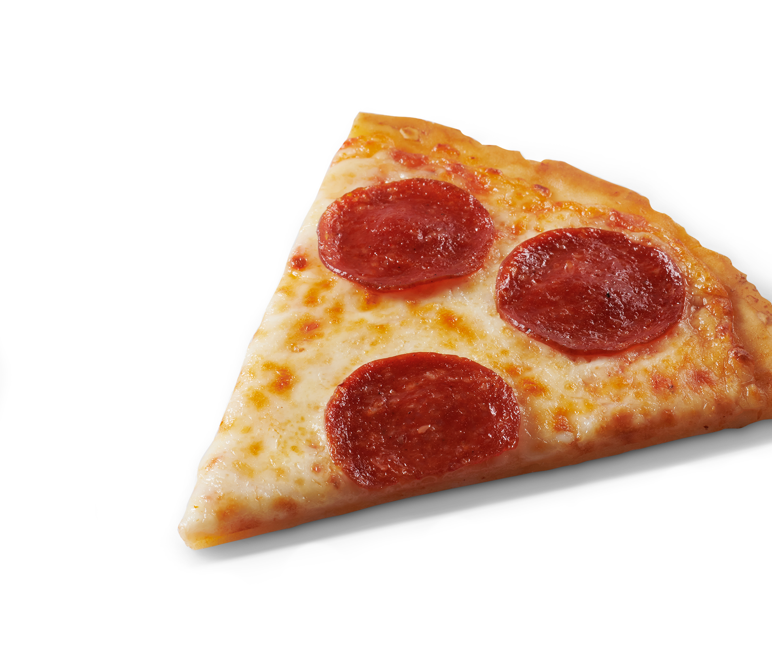
Gluten Free
MARKETING KIT
2021

Slide 2
MARKETING KIT GUIDELINES
This Marketing Kit is designed with assets for field teams to leverage so they can reach shoppers across the path to purchase in the retailer's digital channels. All assets are designed for Pre-Shop planning and have a consistent look and feel.
CIRCULAR ASSETS
  Assets include editable files along with FRESCHETTA® pack-shot images.
  Retailers can leverage assets for placement in-ad and can update with correct product mix, description and pricing.
DIGITAL BANNERS
  Assets include editable files. Retailers can add their logo to the banner.
  Retailers can leverage assets for placement on retail websites or ad exchange and can update the CTA based on click-through destination.
  Banner ads should link to FRESCHETTA® product information on the retailer’s site or digital coupons (if available).
SOCIAL MEDIA
  Assets include digital-ready images that can be used on retailer’s Facebook, Twitter and Instagram channels.
  Social post copy provided. Retailers can adjust copy to align with their social voice/tone and can highlight special offers or deals available on the retailer’s site.
  Social posts should link to FRESCHETTA® product information on retailer’s site or digital incentives (if available).

Slide 3
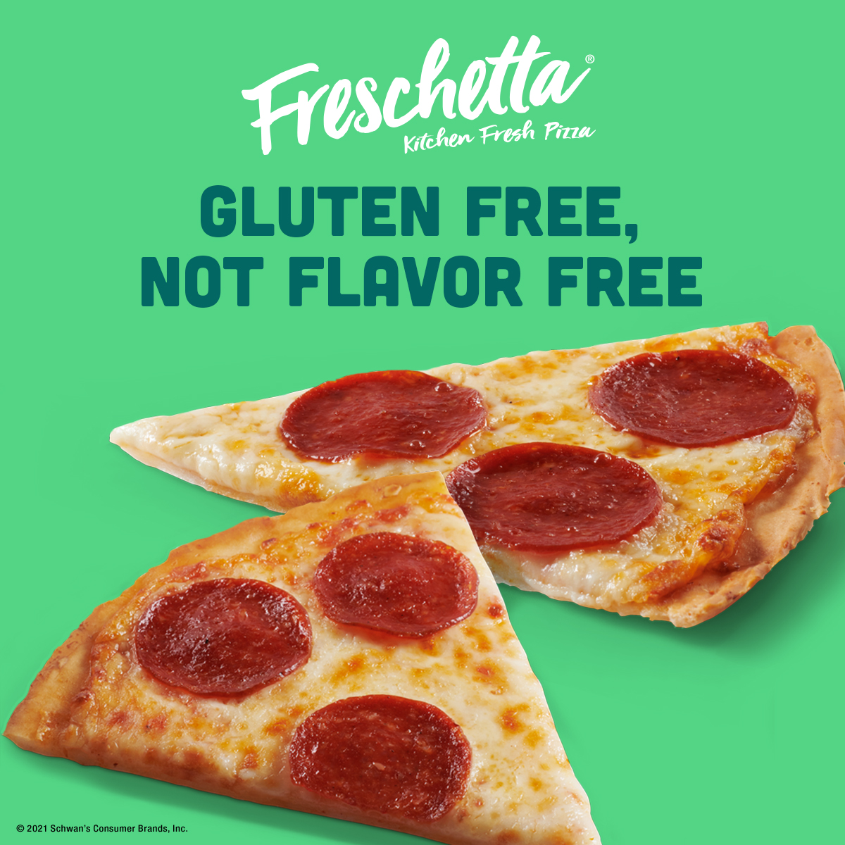
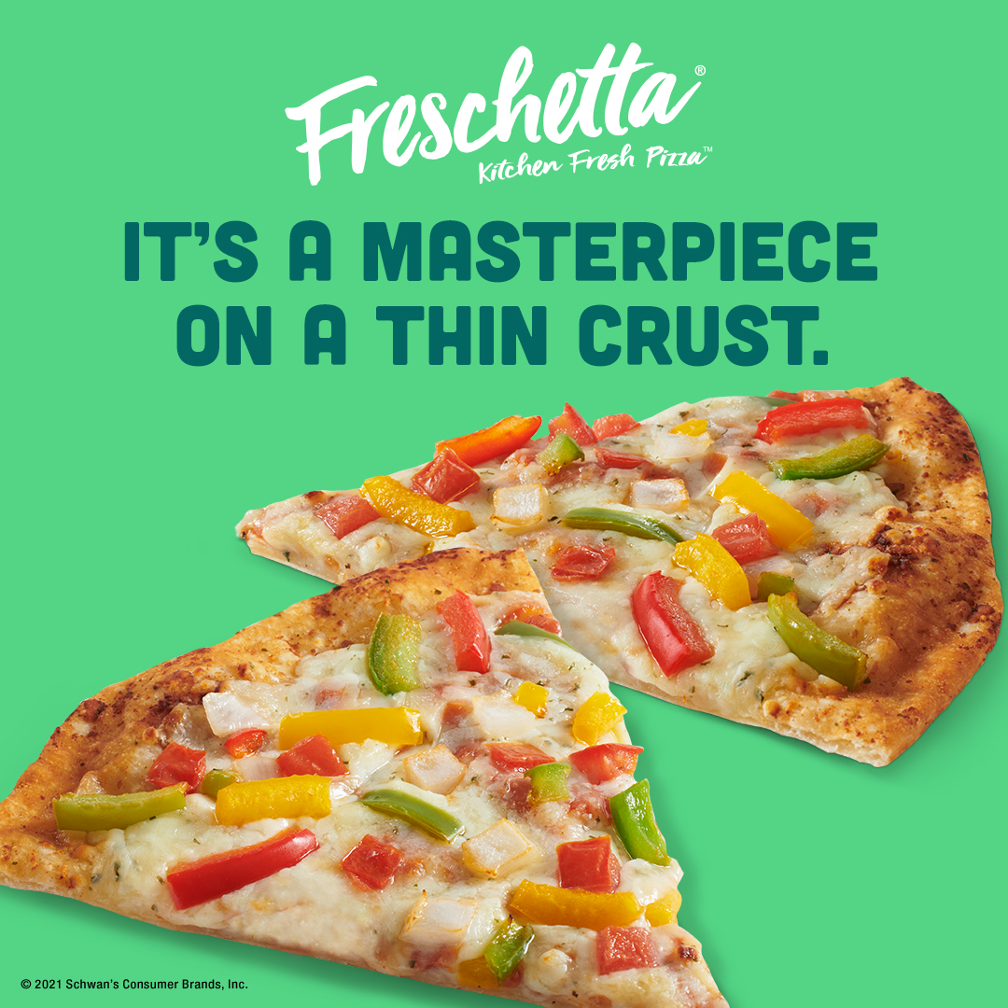
THIN CRUST MARKETING KIT
DOWNLOADABLE ASSETS & PRINTED CLINGS
DOWNLOAD ASSETS: CLICK HERE
DELIVERABLES
Circular Ad Layouts
3" W x 3" H and 10" W x 3" H
Digital
Standard banners: 300 x 250, 728 x 90, 160 x 600 and 320 x 50
Social Media
Facebook newsfeed ad: 1200 x 1200 pixels
Instagram: 1080 x 1080 pixels
Twitter: 1200 x 675 pixels
+ post copy options
HAVE QUESTIONS OR NEED ADDITIONAL SUPPORT? CONTACT:
Christa Bundt Christa.Bundt@Schwans.com

Slide 4
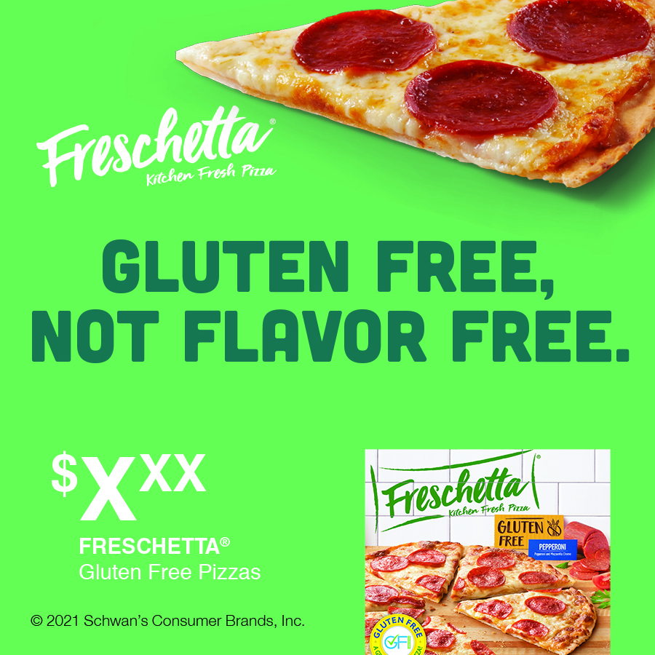
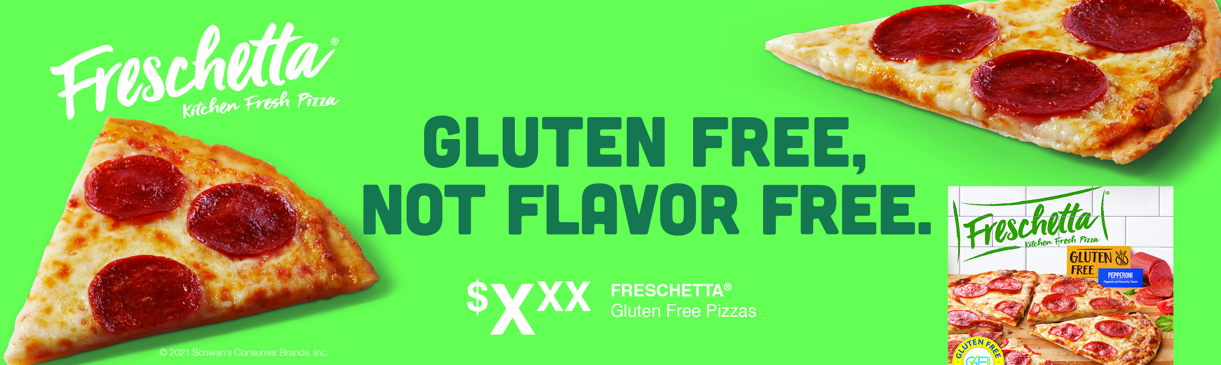
CIRCULAR ADS
CIRCULAR AD LAYOUTS
3" W x 3" H
10" W x 3" H
3" W X 10" H
10" W X 3" H

Slide 5
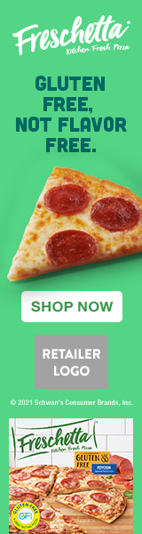
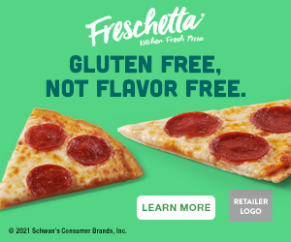


DIGITAL BANNERS
DIGITAL AD LAYOUTS
300 x 250
728 x 90
160 x 600
320 x 50
300 x 250
320 x 50
728 x 90
SHOWN AT 75%
160 x 600
SHOWN AT 75%

Slide 6

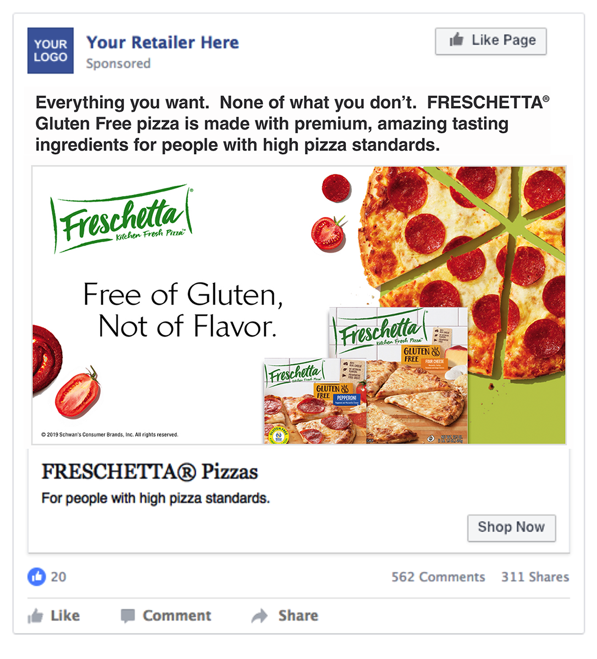
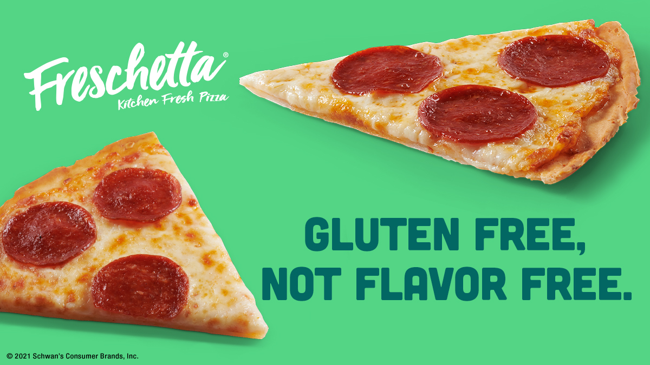
SOCIAL MEDIA
SOCIAL LAYOUTS
Facebook newsfeed ad: 1200 x 1200
Instagram: 1080 x 1080
Twitter: 1200 x 675
FACEBOOK
INSTAGRAM
TWITTER
SOCIAL POST COPY OPTIONS
Everything you want. None of what you don’t. Freschetta® Gluten Free pizza is made with premium, amazing tasting ingredients for people with high pizza standards.
A light and crispy crust that just happens to be gluten free, topped with premium, high quality ingredients for an amazing tasting pizza.
FACEBOOK
Call to Action Options: Shop Now, Save Now, Learn More

Slide 7
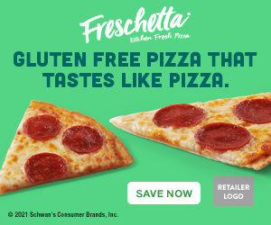

DIGITAL COPY and CTA OPTIONS
ALT DIGITAL CTA OPTIONS
ALT COPY OPTIONS
CTA Options:
Learn More Link to the product page on the retailer's website for product information.
Shop Now Link to the product page on the retailer's website to add to cart if they have this capability.
Save Now Link to a coupon or offer.
Alt headline options for Circulars, Banners, and Social Creative:
Gluten free pizza that tastes like pizza.
300 x 250
LEARN MORE
300 x 250
SAVE NOW
300 x 250
SHOP NOW

