Slide 1
Tony’s Marketing Kit
New Look. Same Yummy Taste.
March 1st 2021

Slide 2
Marketing kit guidelines
Leverage the assets within this marketing kit to delight and inspire TONY’S™ shoppers along the path to purchase.
Leverage retailer channels: placements in communications and tactics pre-shop (digital and circular).
Leverage marketing kit assets to have a consistent look and feel at all touch points during the campaign.
CIRCULAR ASSETS
Assets will include editable files along with TONY’S™ pack-shot images.
Leverage assets for placement in-ad and can update with correct product mix, description and pricing.
DIGITAL BANNERS
Assets will include editable files. Retailers can add their logo to the banner.
Leverage assets for placement on retail websites or ad exchange and can update the CTA based on click-through destination.
Click-through: all banner ads should link to TONY’S™ product information on the brand’s site, retailer’s site or digital incentives (if available).
SOCIAL MEDIA
Assets will include digital-ready images that can be used on retailer’s Facebook, Twitter and Instagram channels.
Social post copy will be provided. Retailers can adjust copy to align with their social voice/tone and can highlight special offers or deals available on Tonys.com or the retailer’s site.
Click-through/link: social posts should link to TONY’S™ product information on brand’s site, retailer’s site or digital incentives (if available).

Slide 3
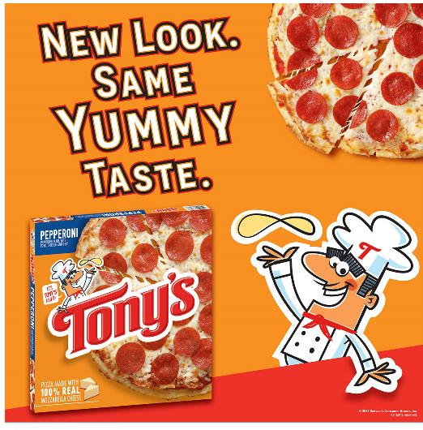
Downloadable assets
DELIVERABLES
Circular Ad Layouts
3" W x 3" H and 10" W x 3" H
Digital
Standard banners:
300 x 250, 728 x 90, 160 x 600 and 320 x 50
Social Media
Facebook newsfeed ad: 1,200 x 628 pixels
Instagram: 1,080 x 1,080 pixels
Twitter: 800 x 320 pixels
+ post copy options for all platforms
DOWNLOAD ASSETS:
CLICK HERE
HAVE QUESTIONS OR NEED ADDITIONAL SUPPORT?
Contact: Christa Bundt Christa.Bundt@schwans.com

Slide 4
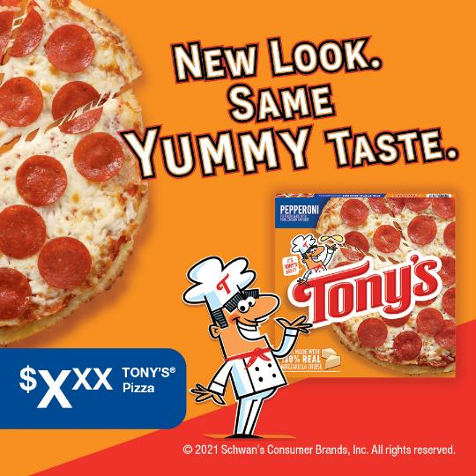
Circular ads
Circular Ad Layouts
3" W x 3" H and 10" W x 3" H
3" W X 3" H
10" W X 3" H

Slide 5
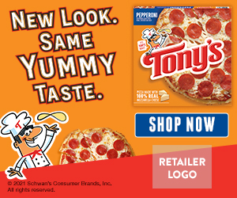
Digital banner ads
Digital Standard Banners
300 x 250 728 x 90 160 x 600 320 x 50
320 x 50
300 x 250
728 x 90
160 x 600

Slide 6
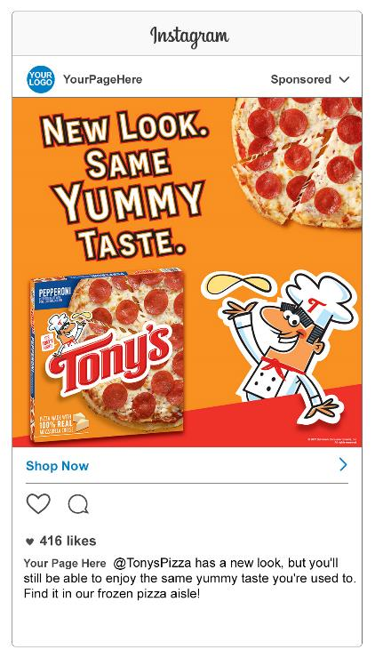
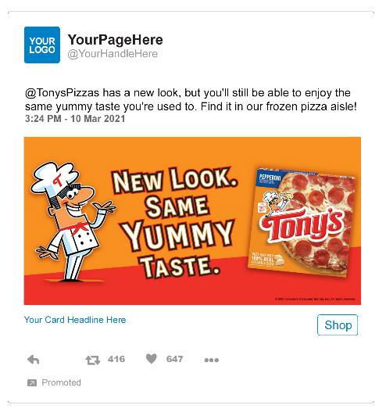
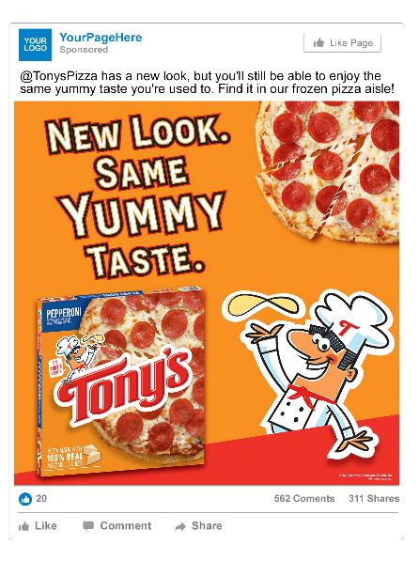
social assets
Facebook newsfeed ad: 1,200 x 628 Instagram: 1,080 x 1,080 Twitter: 800 x 320
TWITTER
FACEBOOK
SOCIAL POST COPY
INSTAGRAM
@TonysPizza has a new look, but you’ll still be able to enjoy the same yummy taste you’re used to. Find it in our frozen pizza aisle!

