Slide 1
PAGODA® Marketing Kit
2022

Slide 2
Marketing Kit Guidelines
Leverage the assets within this marketing kit to delight and inspire PAGODA® shoppers along the path to purchase.
Leverage retailer channels: placements in communications and tactics pre-shop (digital and circular).
Leverage marketing kit assets to have a consistent look and feel at all touch points during the campaign.
CIRCULAR ASSETS
Assets will include editable files along with PAGODA® pack-shot images.
Retailers can leverage assets for placement in-ad and can update with correct product mix, description and pricing.
DIGITAL BANNERS
Assets will include editable files. Retailers can add their logo to the banner.
Retailers can leverage assets for placement on retail websites or ad exchange and can update the CTA based on click-through destination.
Banner ads should link to PAGODA® product information on the retailer’s site or digital coupons (if available).
SOCIAL MEDIA
Assets will include digital-ready images that can be used on retailer’s Facebook, Twitter and Instagram channels.
Social post copy will be provided. Retailers can adjust copy to align with their social voice/tone and can highlight special offers or deals available on the retailer’s site.
Social posts should link to PAGODA® product information on retailer’s site or digital incentives (if available).

Slide 3
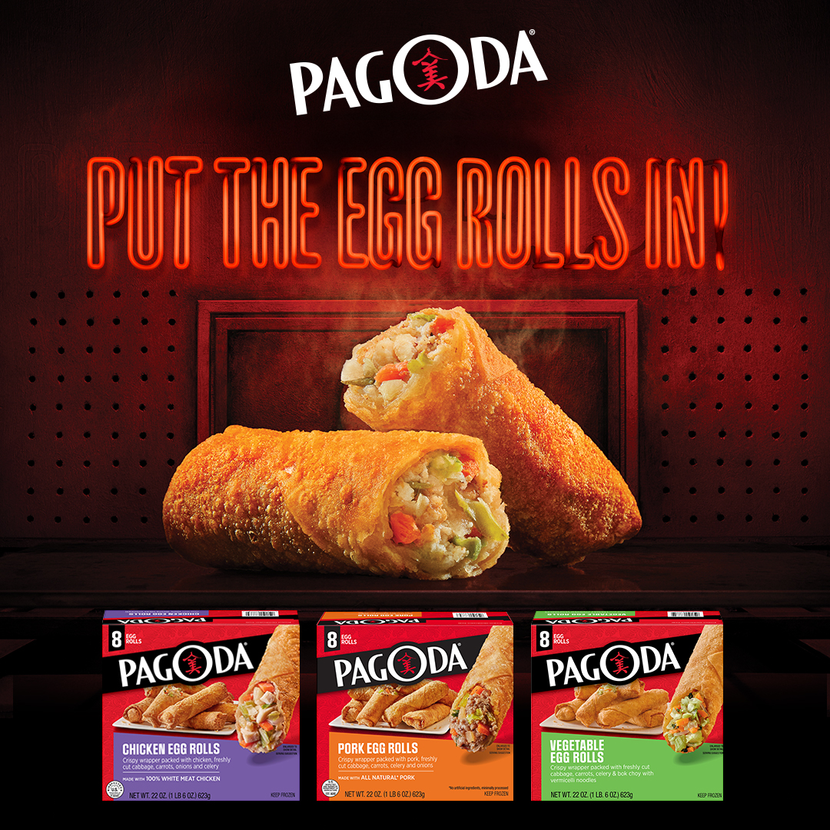
Marketing Kit
DOWNLOADABLE ASSETS
DOWNLOAD ASSETS: CLICK HERE
HAVE QUESTIONS OR NEED ADDITIONAL SUPPORT?
CONTACT: Christa Bundt
Christa.Bundt@Schwans.com
DELIVERABLES
Circular Ad Layouts
3" W x 3" H and 10" W x 3" H
Digital
Standard banners: 300 x 250, 728 x 90, 160 x 600 and 320 x 50
Social Media
Facebook newsfeed ad: 1200 x 630 pixels
Instagram: 1080 x 1080 pixels
Twitter: 1200 x 675 pixels
+ post copy options

Slide 4
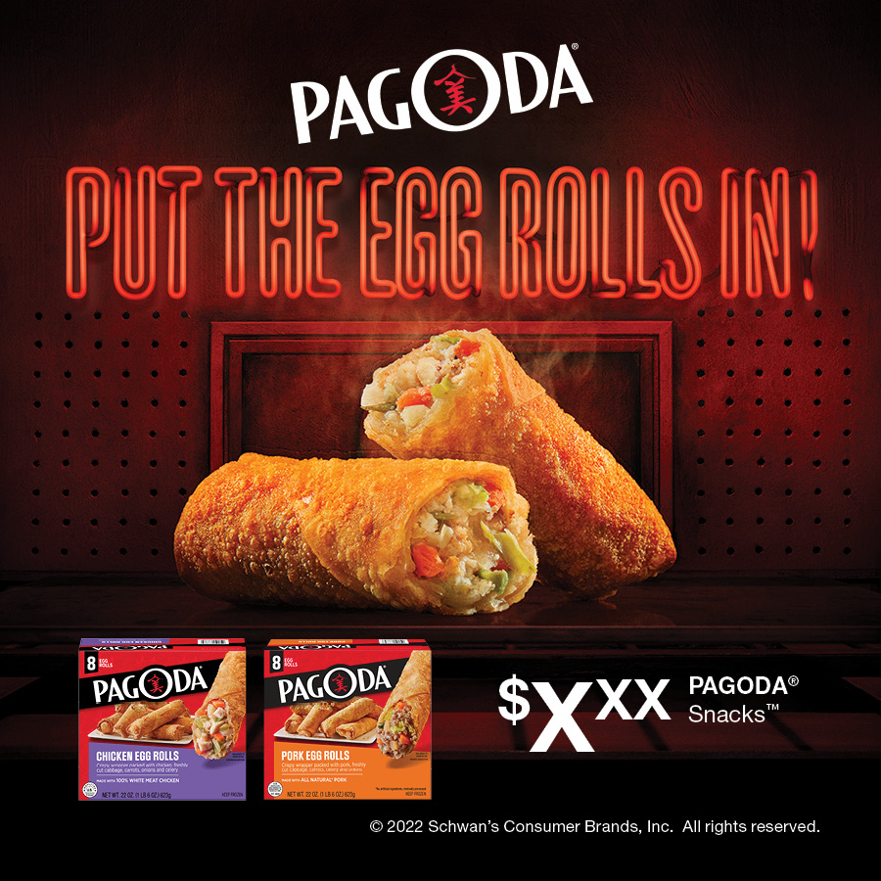
Circular Ads
CIRCULAR AD LAYOUTS
3" W x 3" H
10" W x 3" H
3" W X 10" H
10" W X 3" H

Slide 5
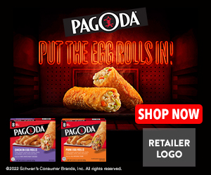
Digital Banners
DIGITAL AD LAYOUTS
300 x 250
728 x 90
160 x 600
320 x 50
300 x 250
320 x 50
728 x 90 SHOWN AT 75%
160 x 600 SHOWN AT 75%

Slide 6
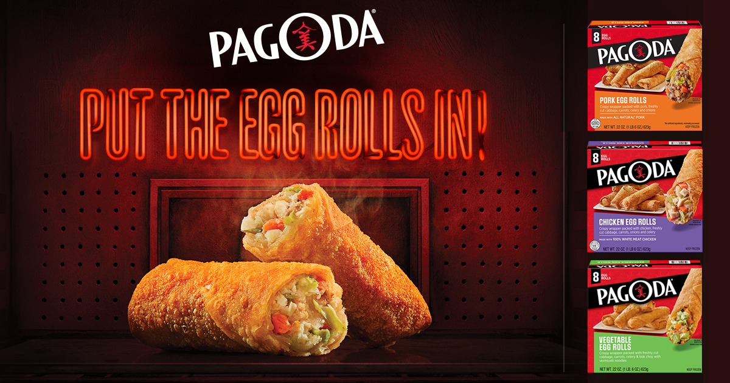
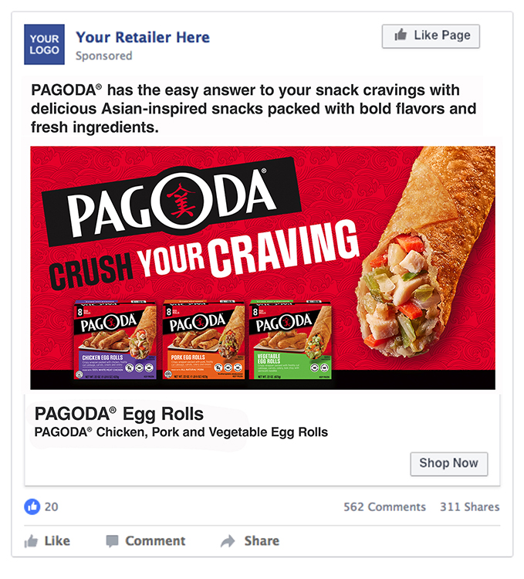
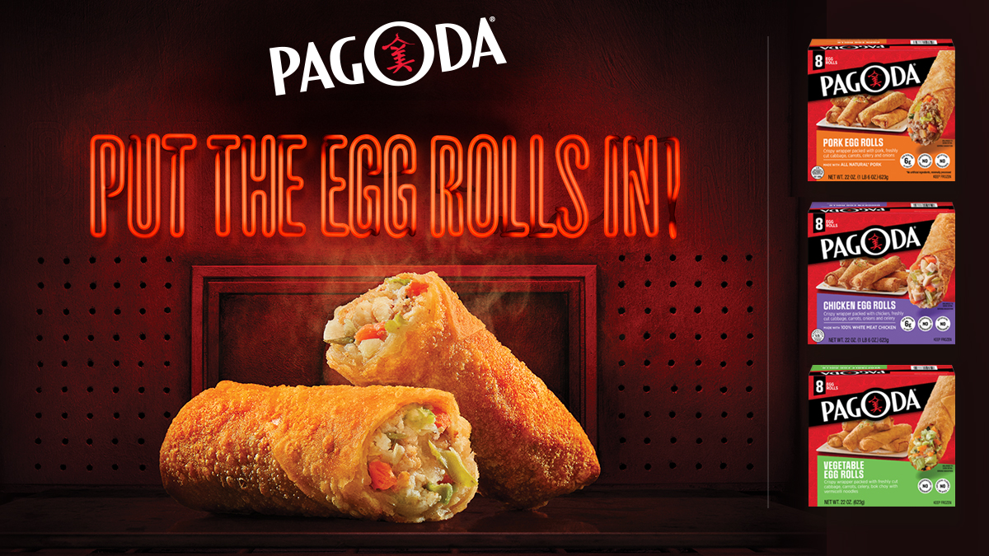
Social Media
SOCIAL LAYOUTS
Facebook newsfeed ad: 1200 x 630 Instagram: 1080 x 1080 Twitter: 1200 x 675
FACEBOOK
PAGODA® has the easy answer to your snack cravings with delicious Asian-inspired snacks packed with bold flavors and fresh ingredients.
INSTAGRAM
SOCIAL POST COPY OPTIONS
TWITTER
Pagoda has the easy answer to your snack cravings with delicious Asian-inspired snacks packed with bold flavors and fresh ingredients.
Satisfy your snack cravings with delicious Asian-inspired snacks from Pagoda, packed with bold flavors and fresh ingredients.
Pagoda is packed with bold flavors and fresh ingredients, wrapped up and ready for you anytime your craving hits.
Now in the freezer aisle
FACEBOOK

Slide 7
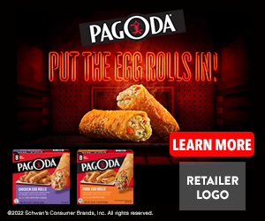
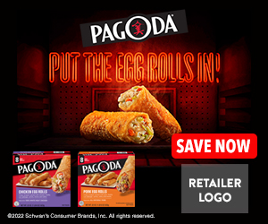
Digital Copy and CTA Options
ALT DIGITAL CTA OPTIONS
ALT COPY OPTIONS
Learn More, Shop Now or Save Now CTA Options:
Link to the product page on the retailer's website for product information (CTA: Learn More).
Link to a coupon or offer (CTA: Save Now).
Link to the product page on the retailer's website to add to cart if this capability is available (CTA: Shop Now).
Alt headline option for Circulars, Banners, and Social Creative:
Crispy. Crunchy. Craveable.
Big Craving. Bigger Flavor.
300 x 250 LEARN MORE
300 x 250 SAVE NOW
300 x 250 SHOP NOW

