Slide 1
MARCH MADNESS
MARKETING KIT
SCHWAN’S CONSUMER BRANDS—2023

Slide 2
MARKETING KIT GUIDELINES
Leverage marketing kit assets to show how RED BARON®, TONY’S® and FRESCHETTA® are great crowd-pleasers for a basketball tournament watch party.
Leverage retailer channels: placements in communications and tactics pre-shop (digital and circular).
CIRCULAR ASSETS
Assets will include editable files along with RED BARON®, TONY’S® and FRESCHETTA® pack-shot images.
Leverage assets for placement in-ad and can update with correct product mix, description and pricing.
DIGITAL BANNERS
Assets will include editable files. Retailer can add their logo to the banner.
Leverage assets for placement on retail websites or ad exchange and can update the CTA based on click-through destination.
Click-through: all banner ads should link to RED BARON®, TONY’S® and FRESCHETTA® product information on the retailer’s site or digital incentives (if available).
SOCIAL MEDIA
Assets will include digital-ready images that can be used on retailer’s Facebook, Twitter and Instagram channels.
Social post copy will be provided. Retailers can adjust copy to align with their social voice/tone and can highlight special offers or deals available on the retailer’s site.
Click-through/link: social posts should link to RED BARON®, TONY’S® and FRESCHETTA® product information on retailer’s site or digital incentives (if available).

Slide 3
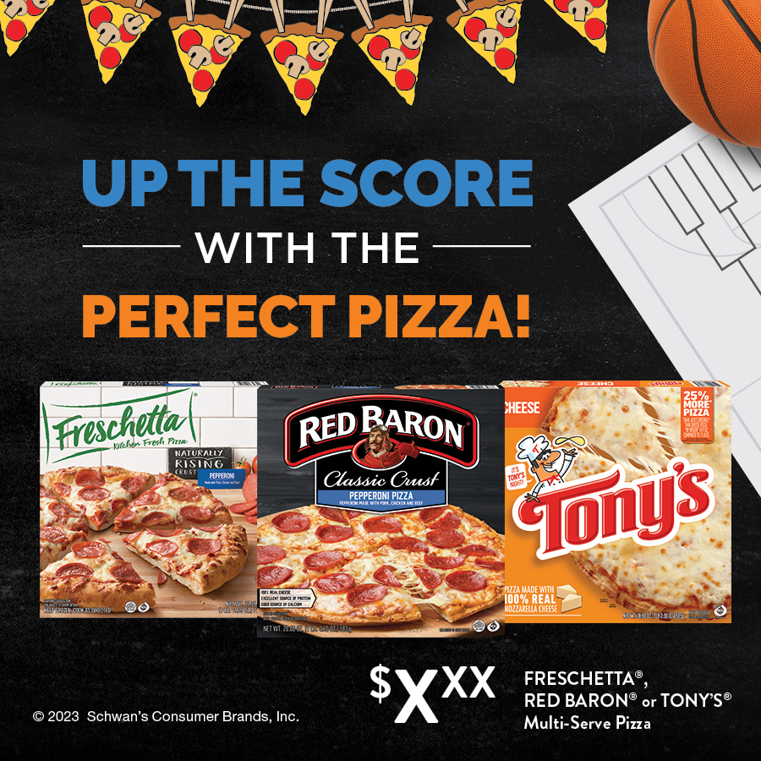
MARCH MADNESS MARKETING KIT
DELIVERABLES
Circular Ad Layouts
3" W x 3" H and 10" W x 3" H
Digital
Standard banners:
300 x 250, 728 x 90, 160 x 600
Social Media
Instagram: 1080 x 1080 pixels
Facebook: 1200 x 1200 pixels
Twitter: 1200 x 1200 pixels
+ post copy options for all platforms
For single brand promos, alt SKU packs included as JPGs.
DOWNLOAD ASSETS: CLICK HERE
HAVE QUESTIONS OR NEED ADDITIONAL SUPPORT?
Contact: Taylor Witort Taylor.Witort@schwans.com

Slide 4
CIRCULAR ADS
Circular Ad Layouts
3" W x 3" H and 10" W x 3" H
PLEASE NOTE: PHOTOSHOP FILES CONTAIN SEPARATE PACK-SHOT SMART-OBJECT LAYERS, WHICH CAN BE SWAPPED IN OR OUT OR REARRANGED, DEPENDING ON WHICH BRANDS ARE BEING PROMOTED.
3" W X 3" H
10" W X 3" H

Slide 5
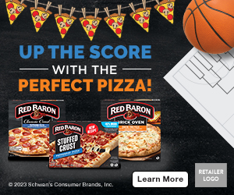
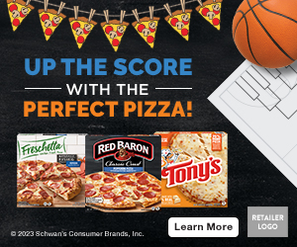
DIGITAL BANNERS
Digital Standard Banners
300 x 250 728 x 90 160 x 600
Alt CTAs:
PLEASE NOTE: LAYERED PHOTOSHOP FILES FOR EACH SIZE CONTAIN CTAs (SHOP NOW, SAVE NOW AND LEARN MORE THAT CAN BE SWAPPED OUT.
300 x 250 ALT
PLEASE NOTE: photoshop files contain separate pack-shot smart-object layers, which can be swapped in or out or rearranged, depending on which brands are being promoted. also, each banner size contains the 2 cta options (shop now; learn more), which can be swapped.
300 x 250
728 x 90
160 x 600

Slide 6
DIGITAL BANNERS
Learn More, Shop Now or Save Now CTA Options:
Link to the product page on the retailer's website for product information (CTA: Learn More).
Link to the product page on the retailer's website to add to cart if they have this capability (CTA: Shop Now).
Link to a coupon or offer (CTA: Save Now).
300 x 250 SHOP NOW
300 x 250 SAVE NOW
300 x 250 LEARN MORE

Slide 7
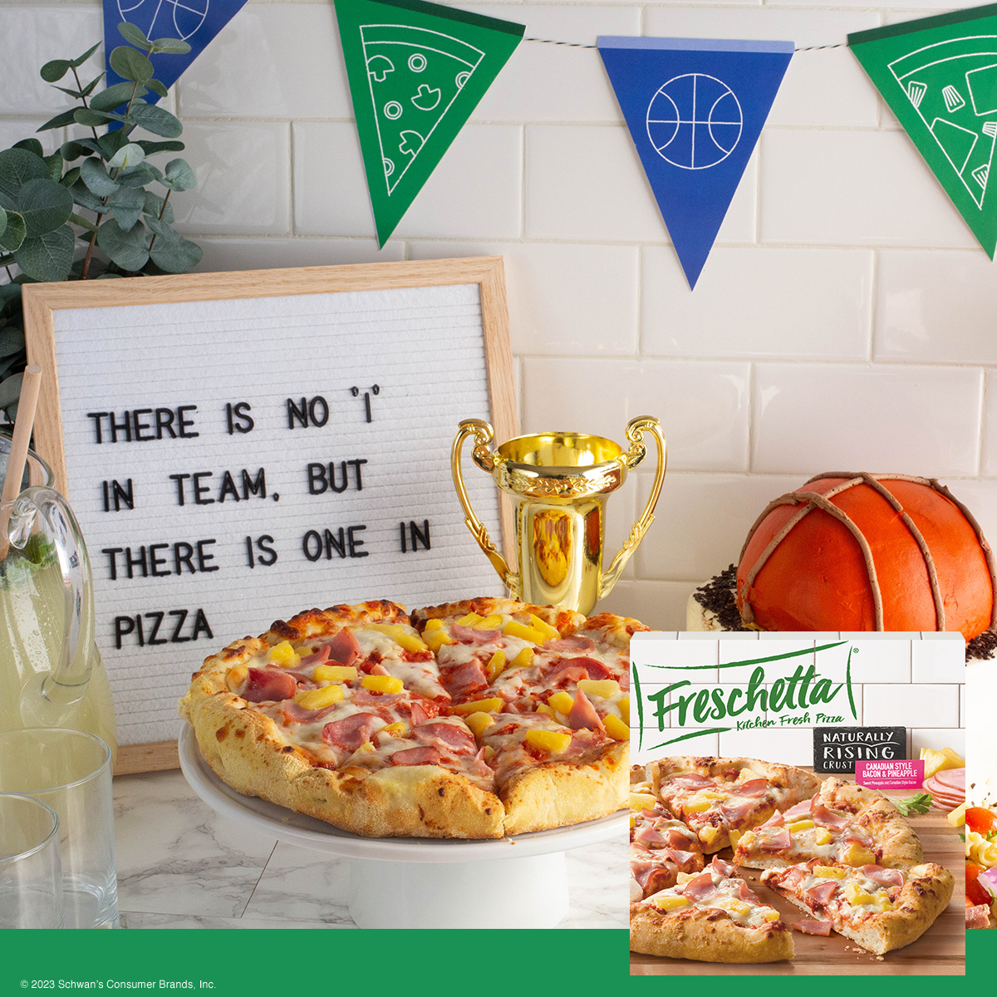
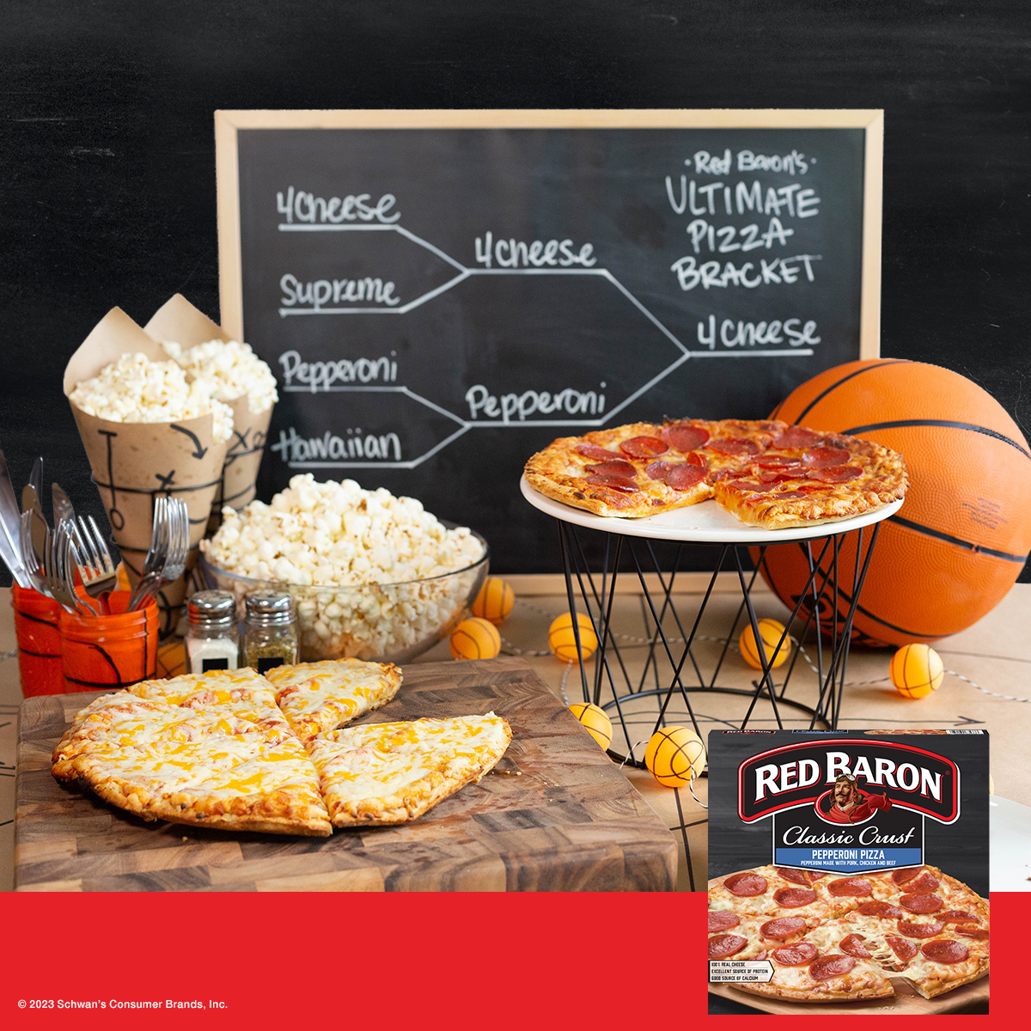
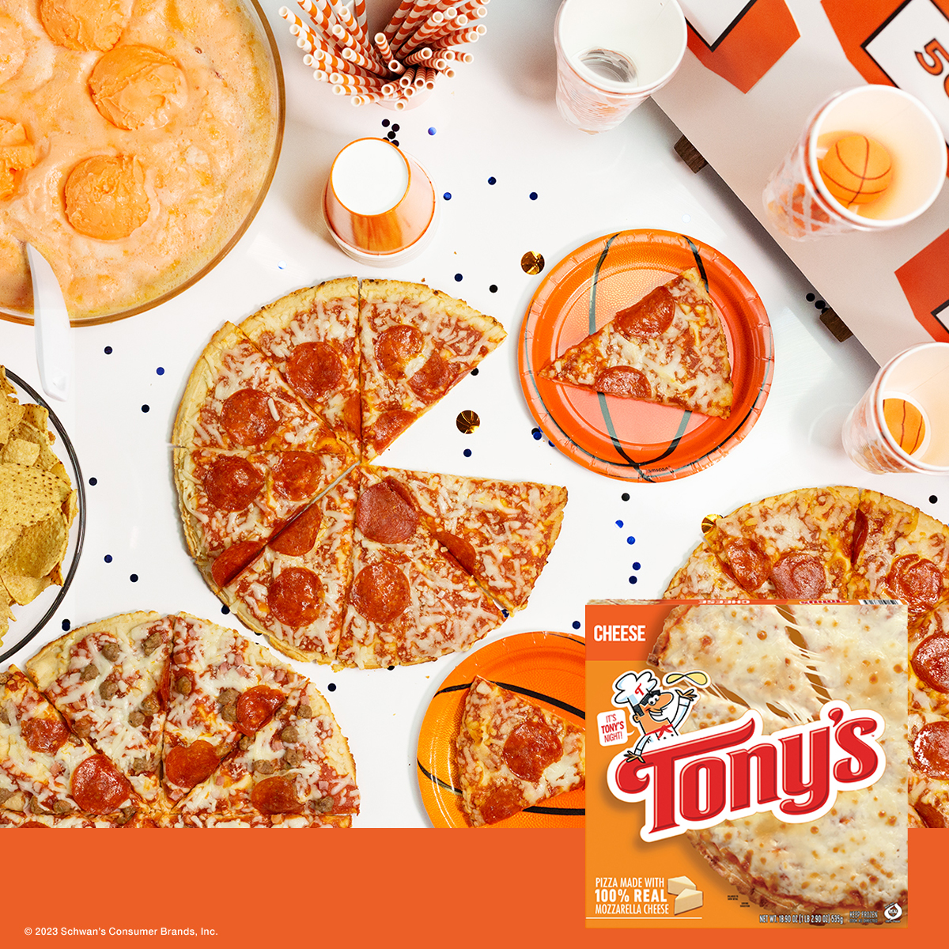
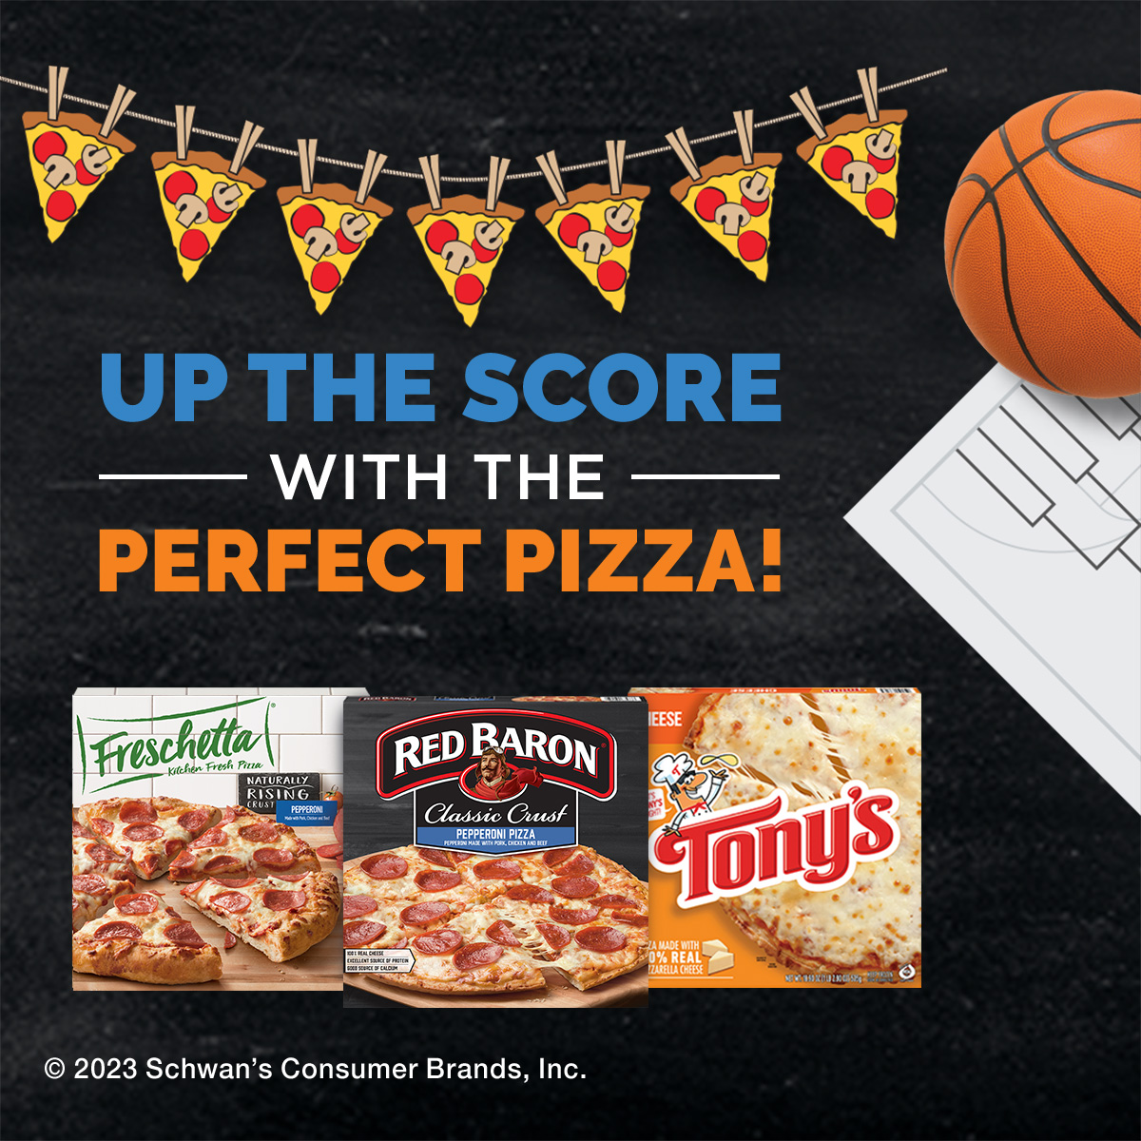
SOCIAL MEDIA
Instagram: 1080 x 1080 Facebook: 1200 x 1200 Twitter: 1200 x 1200
Game time means pizza time. Does your team go for extra cheese or all the meats? Four Cheese or Supreme? Gather your squad together and make your own pizza bracket to see what flavor comes out on top.
INSTAGRAM, FACEBOOK & TWITTER
INSTAGRAM, FACEBOOK & TWITTER
INSTAGRAM, FACEBOOK & TWITTER
PLEASE NOTE: photoshop files for the bracket-themed post contain separate pack-shot smart-object layers, which can be swapped in or out or rearranged, depending on which brands are being promoted.
SOCIAL POST COPY OPTIONS
FRESCHETTA Your tournament watch party is almost complete—all it’s missing is the perfect pizza. With preservative-free crusts, premium ingredients and mouth-watering toppings, FRESCHETTA® has everything you want in a pizza and nothing you don’t.
RED BARON Keep your team fed from tip-off to overtime with delicious RED BARON® pizza—the perfect mealtime (and game-time) solution for you and your squad of champions. Game on!
TONY’S Your favorite time of year means your favorite pizza flavors. Experience TONY’S® authentic pizzeria-style pizza during this year’s tourney with a taste that’s a slam dunk for the whole family.
BRACKET Game time means pizza time. Does your team go for extra cheese or all the meats? Four Cheese or Supreme? Gather your squad together and make your own pizza bracket to see what flavor comes out on top.
Your Description Here
FACEBOOK

