Slide 1
STUFFED CRUST MARKETING KIT
2023

Slide 2
MARKETING KIT GUIDELINES
Leverage the assets within this marketing kit to delight and inspire RED BARON® shoppers along the path to purchase.
Leverage retailer channels: placements in communications and tactics pre-shop (digital and circular).
Leverage marketing kit assets to have a consistent look and feel at all touch points during the campaign.
CIRCULAR ASSETS
Assets will include editable files along with RED BARON® pack-shot images.
Leverage assets for placement in-ad and can update with correct product mix, description and pricing.
DIGITAL BANNERS
Assets will include editable files. Retailers can add their logo to the banner.
Leverage assets for placement on retail websites or ad exchange and can update the CTA based on click-through destination.
Click-through: all banner ads should link to RED BARON® product information on the brand’s site, retailer’s site or digital incentives (if available).
SOCIAL MEDIA
Assets will include digital-ready images that can be used on retailer’s Facebook, Twitter and Instagram channels.
Social post copy will be provided. Retailers can adjust copy to align with their social voice/tone and can highlight special offers or deals available on RedBaron.com or the retailer’s site.
Click-through/link: social posts should link to RED BARON® product information on brand’s site, retailer’s site or digital incentives (if available).
FREEZER CLINGS
Work with national account manager to have clings placed in stores, while supplies last.

Slide 3
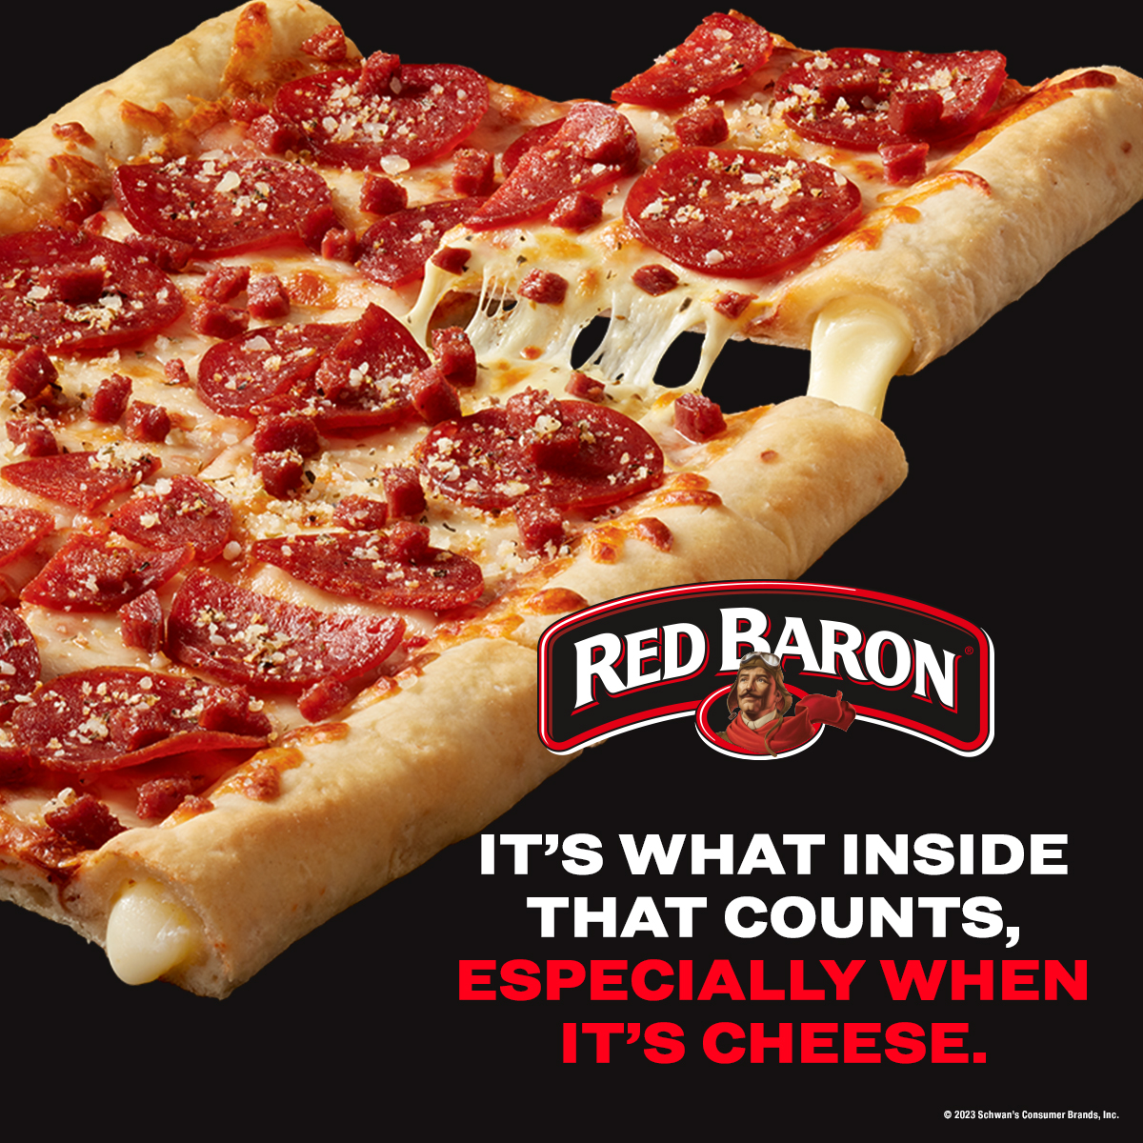

STUFFED CRUST – ASSETS
DELIVERABLES
Circular Ad Layouts
3" W x 3" H and 10" W x 3" H
Digital
Standard banners:
300 x 250, 728 x 90, 160 x 600 and 320 x 50
Social Media
Instagram: 1080 x 1080 pixels
Facebook: 1200 x 1200 pixels
Twitter: 1200 x 1200 pixels
+ post copy options for all platforms
Printed Clings
6" W x 9" H
(available to be placed by service representative)
DOWNLOAD ASSETS:
CLICK HERE
HAVE QUESTIONS OR NEED ADDITIONAL SUPPORT?
Contact: Taylor Witort Taylor.Witort@schwans.com

Slide 4
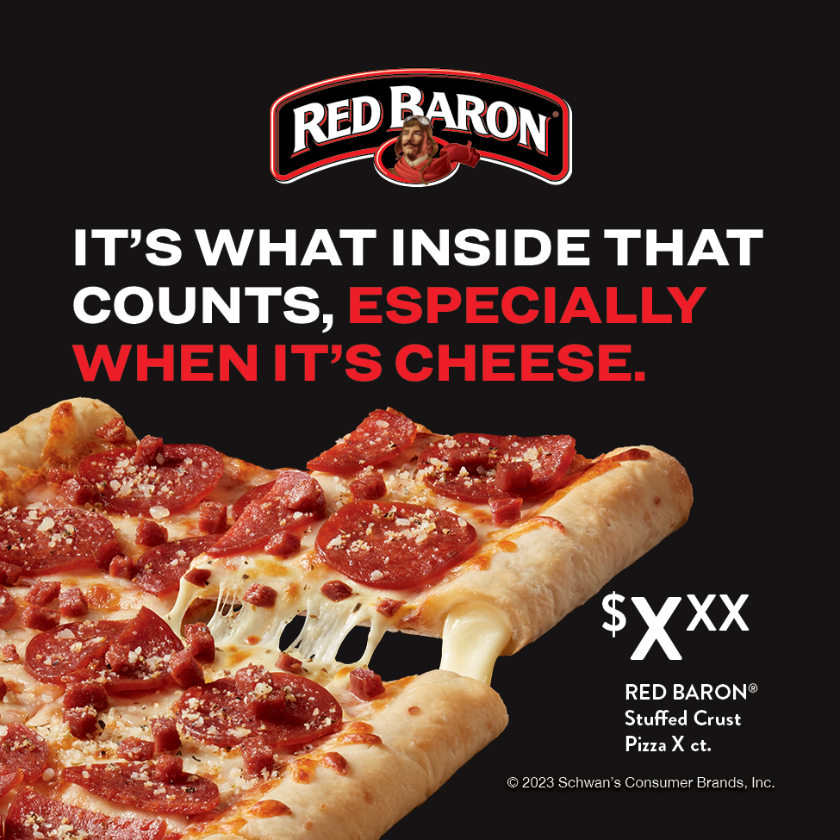
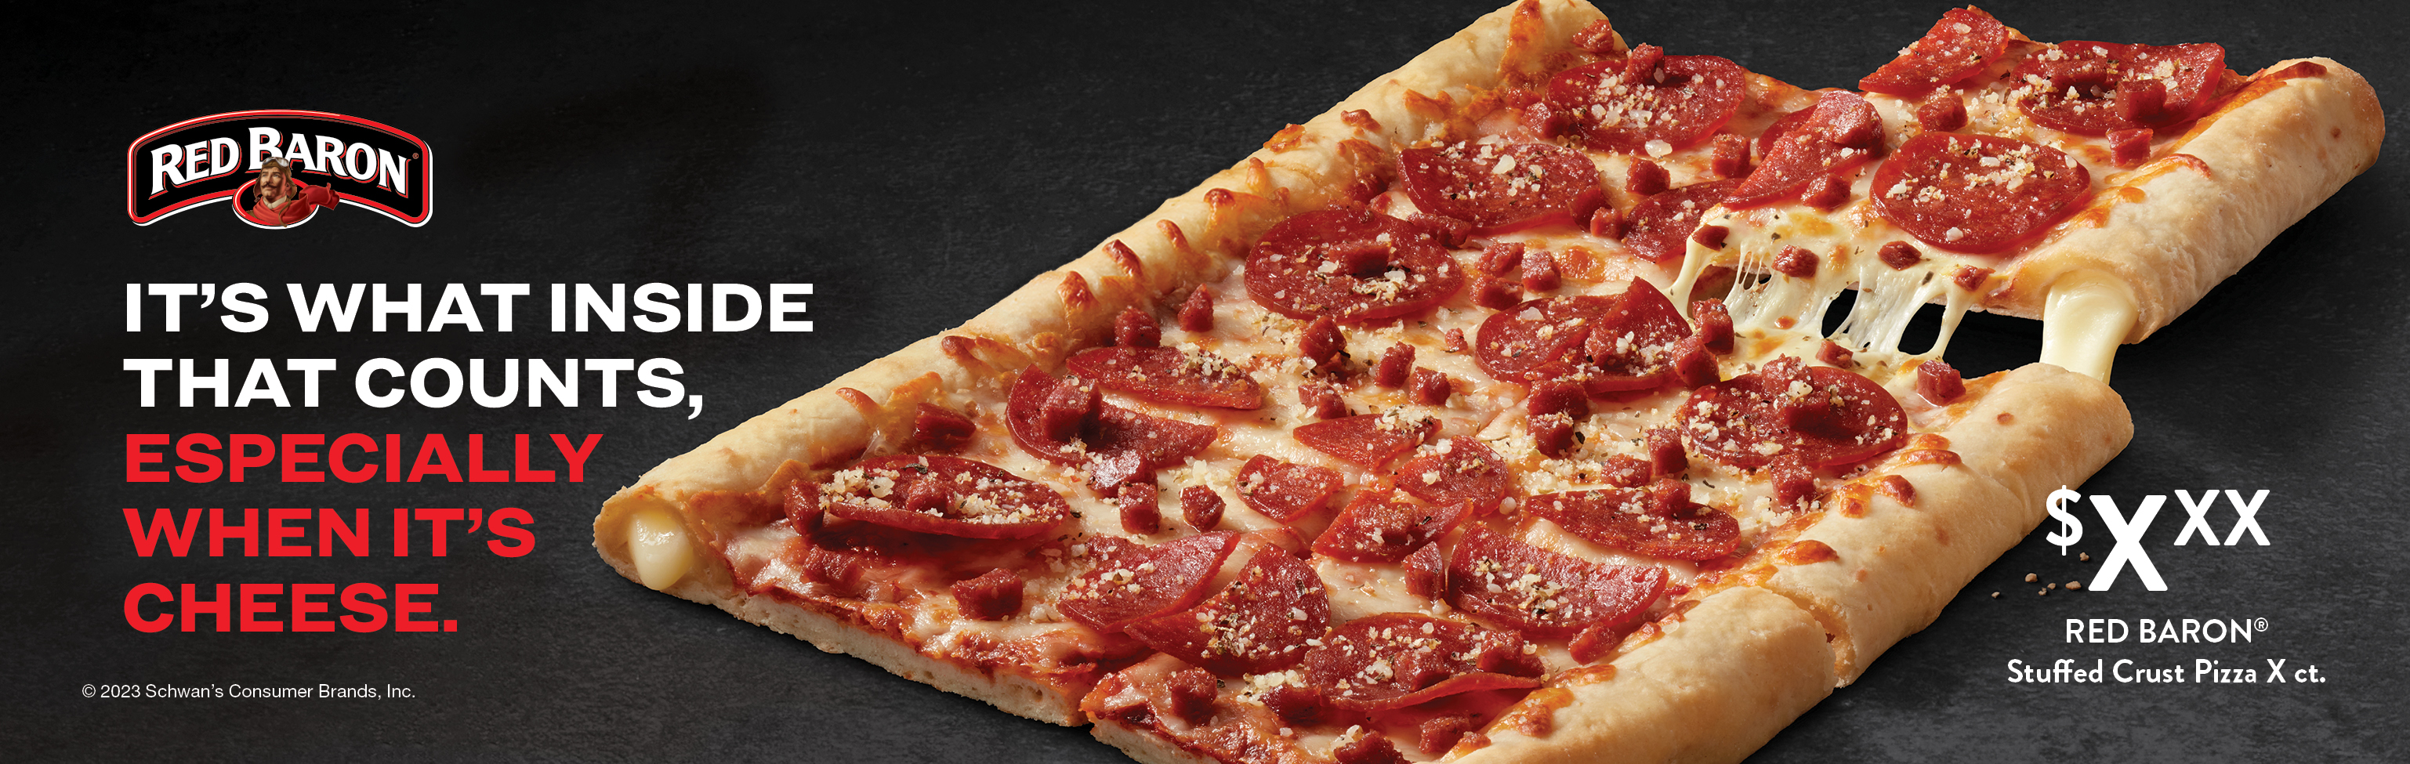
CIRCULAR ADS
Circular Ad Layouts
3" W x 3" H and 10" W x 3" H
PLEASE NOTE: layered photoshop files for each size contain layers for packs & hero pizza image that can be swapped out.
Alt Headline:
We know our stuffed.
3" W X 3" H
10" W X 3" H

Slide 5
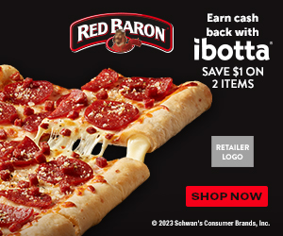

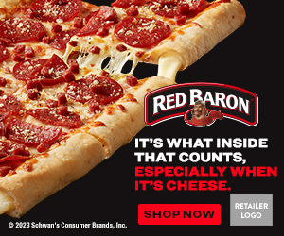


DIGITAL BANNERS
Digital Standard Banners
300 x 250
728 x 90
160 x 600
320 x 50
Alt CTAs:
PLEASE NOTE: layered photoshop files for each size contain CTAs (shop now, save now and learn more that can be swapped out.
300 x 250
Alt Headline:
We know our stuffed.
320 x 50
728 x 90
160 x 600

Slide 6


DIGITAL CTA OPTIONS
Learn More, Shop Now or Save Now CTA Options:
Link to the product page on the retailer's website for product information (CTA: Learn More).
Link to the product page on the retailer's website to add to cart if they have this capability (CTA: Shop Now).
Link to a coupon or offer (CTA: Save Now).
300 x 250
SHOP NOW
300 x 250
SAVE NOW
300 x 250
LEARN MORE

Slide 7

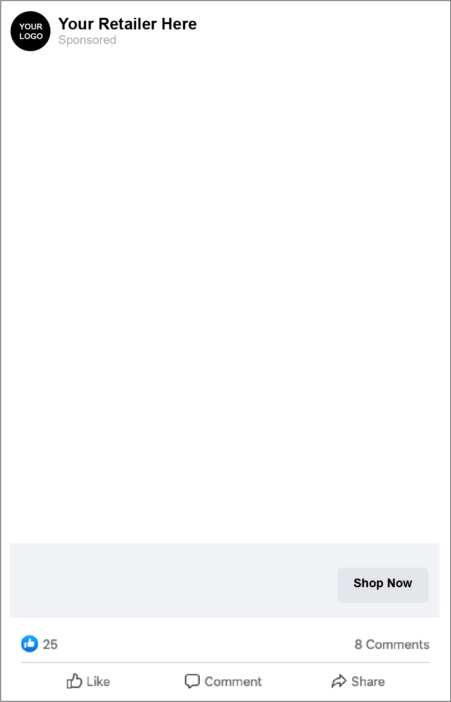
SOCIAL MEDIA
Instagram: 1080 x 1080
Facebook: 1200 x 1200 Twitter: 1200 x 1200
Fill mealtime with melty cheese-filled crust — with Red Baron® Stuffed Crust Pizza! We’re bringing mouth-watering mozzarella to every bite of our fan-favorite crust.
PLEASE NOTE: layered photoshop files for each size contain layers for packs & hero melt image that can be swapped out.
INSTAGRAM
FACEBOOK & TWITTER
SOCIAL POST COPY OPTIONS
Fill mealtime with melty cheese-filled crust — with Red Baron® Stuffed Crust Pizza! We’re bringing mouth-watering mozzarella to every bite of our fan-favorite crust.
Make mealtime even more mouth-watering with melty mozzarella in every bite of Red Baron® Stuffed Crust Pizza. Now available in Pepperoni, Four Cheese and Meat Trio… Mmmmm… Is it pizza time yet??
The only way to improve upon our irresistible crust was to fill it with melty mozzarella cheese. So that’s exactly what we did. Try Red Baron® Stuffed Crust Pizza today and thank us later!!
RED BARON® Stuffed Crust Pizza
Your Description Here

Slide 8
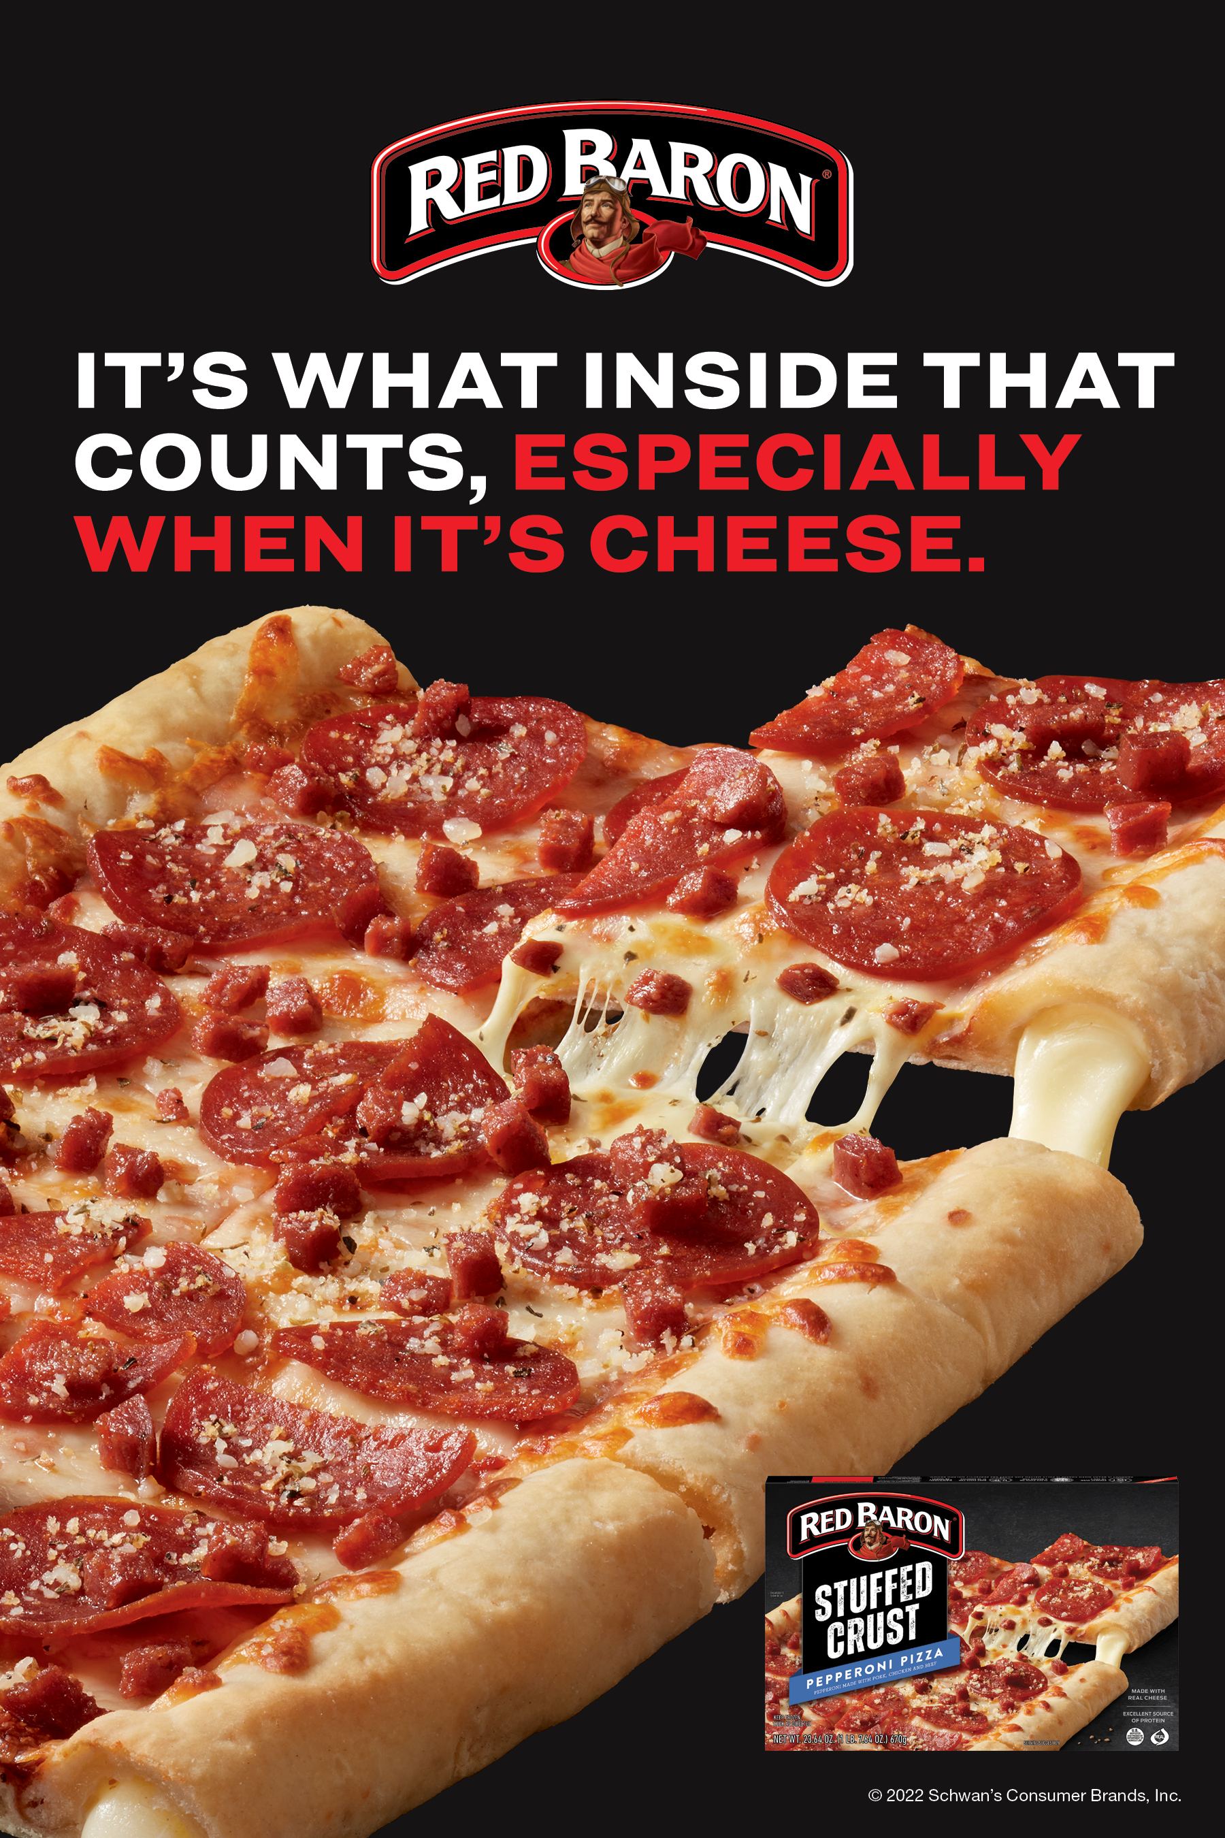
FREEZER CLING
Purpose: Generate awareness in the freezer aisle of the RED BARON® brand and how delicious it is.
Freezer clings are available to order, while supplies last.
Work with national account manager to have clings placed in stores.
Clings should only be placed in locations that do not have a clean-store policy and have been approved to be put up.
6" W x 9" H

