Slide 1
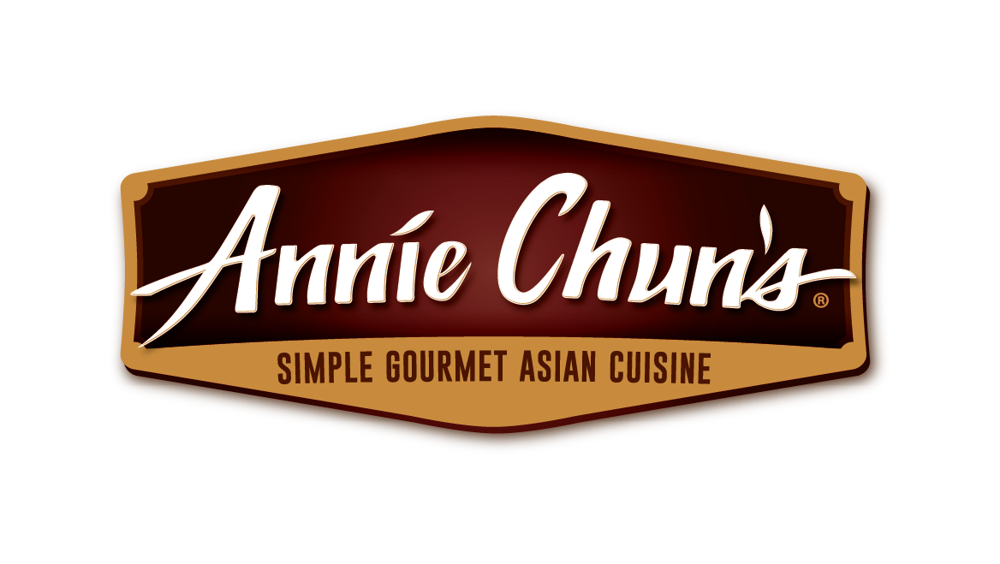
ANNIE CHUN’S ®
SOUP BOWL NOODLE BOWL
MARKETING KIT
Ver.2023.06

Slide 2
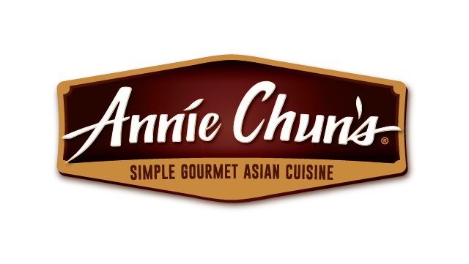
MARKETING KIT GUIDELINES
Leverage the assets within this marketing kit to delight and inspire ANNIE CHUN'S ® shoppers along the path to purchase.
Leverage retailer channels: placements in communications and tactics pre-shop (digital and circular).
Leverage marketing kit assets to have a consistent look and feel at all touch points during the campaign.
CIRCULAR ASSETS
Assets will include editable files along with ANNIE CHUN'S ® pack-shot images.
Leverage assets for placement in-ad and can update with correct product mix, description and pricing.
DIGITAL BANNERS
Assets will include editable files. Retailers can add their logo to the banner.
Leverage assets for placement on retail websites or ad exchange and can update the cta based on click-through destination.
Click-through: all banner ads should link to ANNIE CHUN'S ® product information on the retailer’s site or digital incentives (if available).
SOCIAL MEDIA
Assets will include digital-ready images that can be used on retailer’s facebook, twitter and instagram channels.
Social post copy will be provided. Retailers can adjust copy to align with their social voice/tone and can highlight special offers or
deals available on ANNIECHUN.COM or the retailer’s site.
Click-through/link: social posts should link to ANNIE CHUN'S ® product information on retailer’s site or digital incentives (if available).
ANNIE CHUN'S ® SOUP BOWL NOODLE BOWL

Slide 3
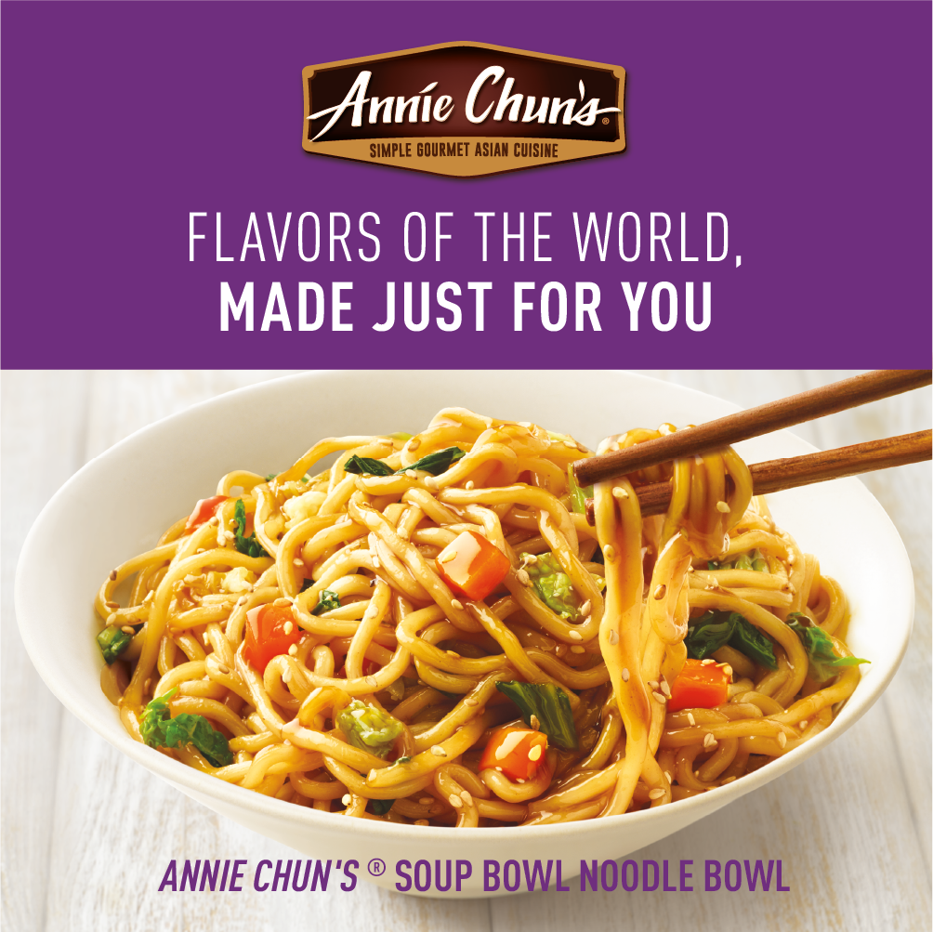
SBNB ASSETS AVAILABLE
DELIVERABLES
CIRCULAR AD LAYOUTS
3" W X 3" H
10" W X 3" H
DIGITAL
Standard banners:
300 X 250
728 X 90
160 X 600
320 X 50
SOCIAL MEDIA
Facebook newsfeed ad: 1,200 x 628 pixels
Instagram: 1,080 x 1,080 pixels
Twitter: 800 x 320 pixels
+ Post copy options
DOWNLOAD ASSETS: CLICK HERE
HAVE QUESTIONS OR NEED ADDITIONAL SUPPORT?
CONTACT: TAYLOR WITORT TAYLOR.WITORT@SCHWANS.COM
ANNIE CHUN'S ® SOUP BOWL NOODLE BOWL

Slide 4
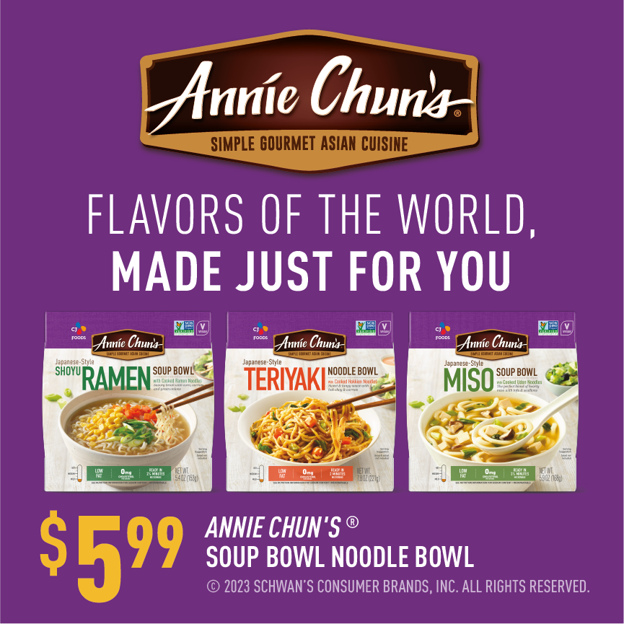
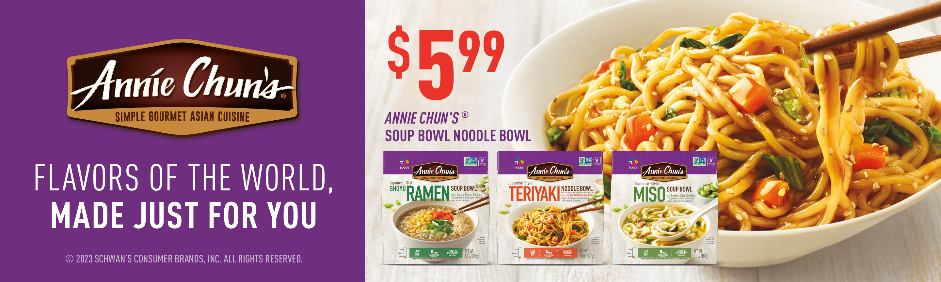
CIRCULAR AD
DELIVERABLES
CIRCULAR AD
3" W X 3" H
10" W X 3" H
PLEASE NOTE: PACKAGED PHOTOSHOP FILES INCLUDE ALT SKU HERO IMAGES.
ALT HEADLINE:
FLAVORS OF THE WORLD, MADE JUST FOR YOU
3" W x 3" H
10" W x 3" H
ANNIE CHUN'S ® SOUP BOWL NOODLE BOWL

Slide 5
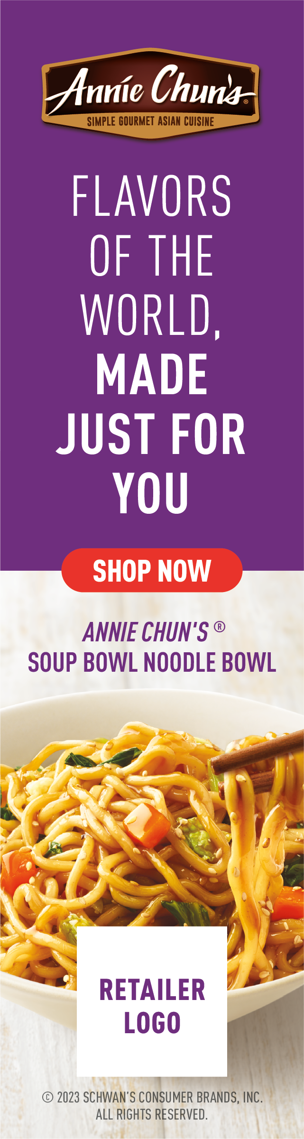

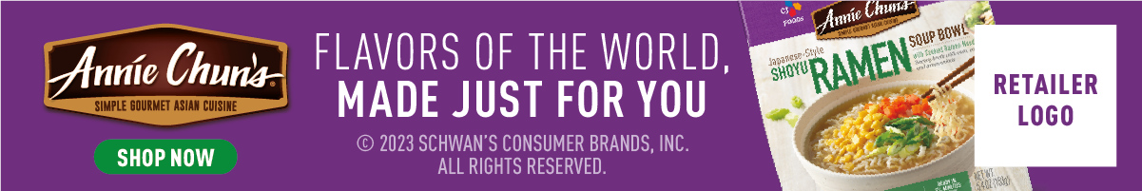
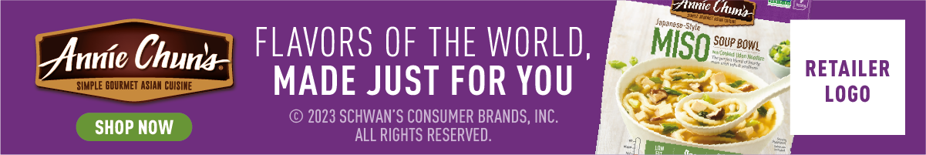
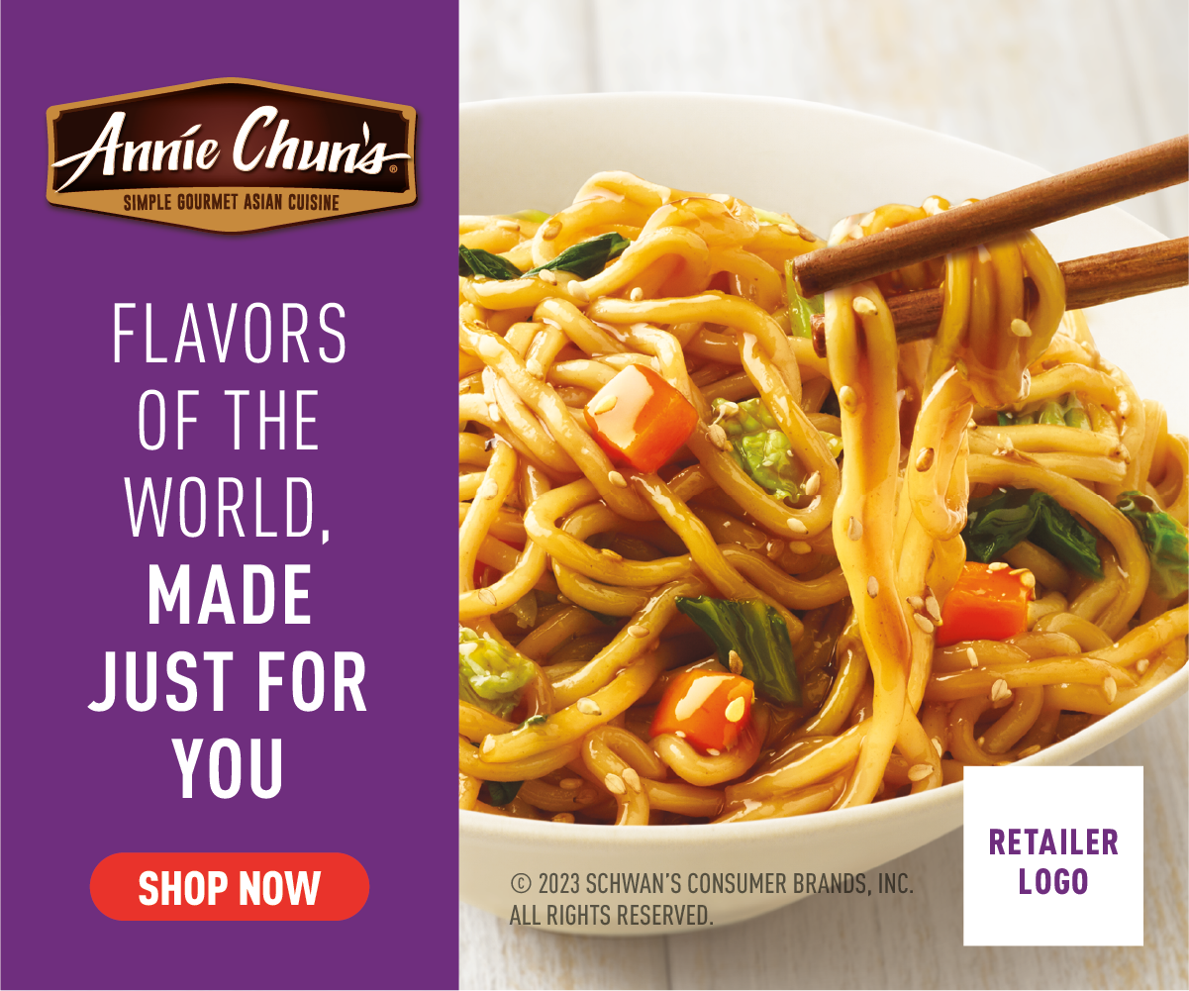
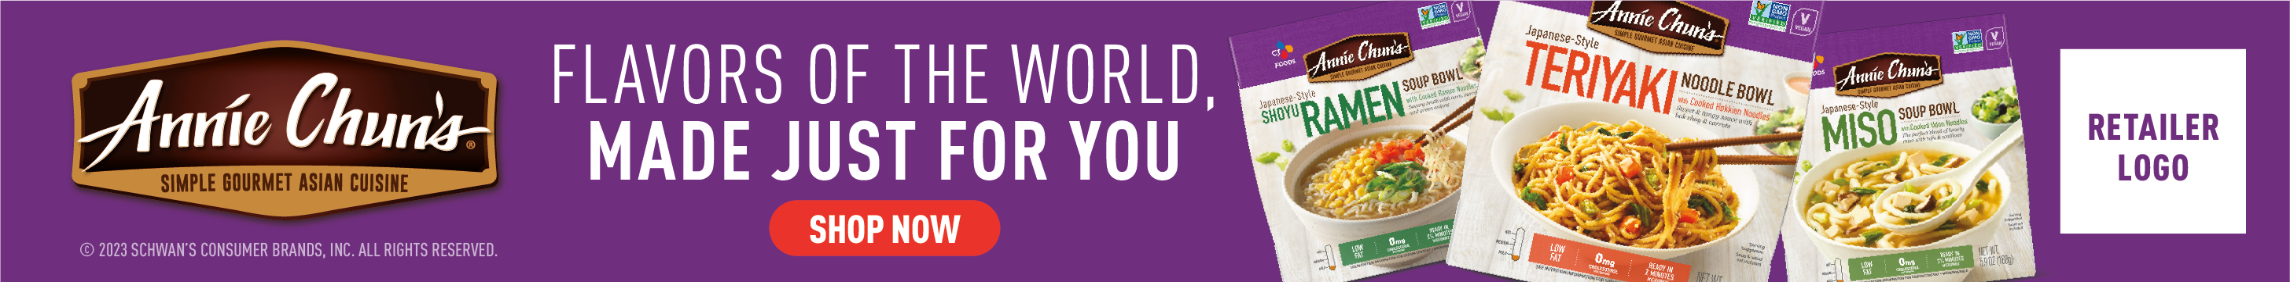
DIGITAL BANNERS
Option A
Option B
STANDARD BANNERS:
300 x 250 pixels
728 x 90 pixels
160 x 600 pixels
320 x 50 pixels
Option C
320 x 50 pixels
ALT CTAS:
PLEASE NOTE: LAYERED PHOTOSHOP FILES FOR EACH SIZE CONTAIN CTAS
(SHOP NOW, SAVE NOW AND LEARN MORE) THAT CAN BE SWAPPED OUT.
ALT HEADLINE:
FLAVORS OF THE WORLD, MADE JUST FOR YOU
300 x 250 pixels
160 x 600 pixels
728 x 90 pixels
ANNIE CHUN'S ® SOUP BOWL NOODLE BOWL

Slide 6

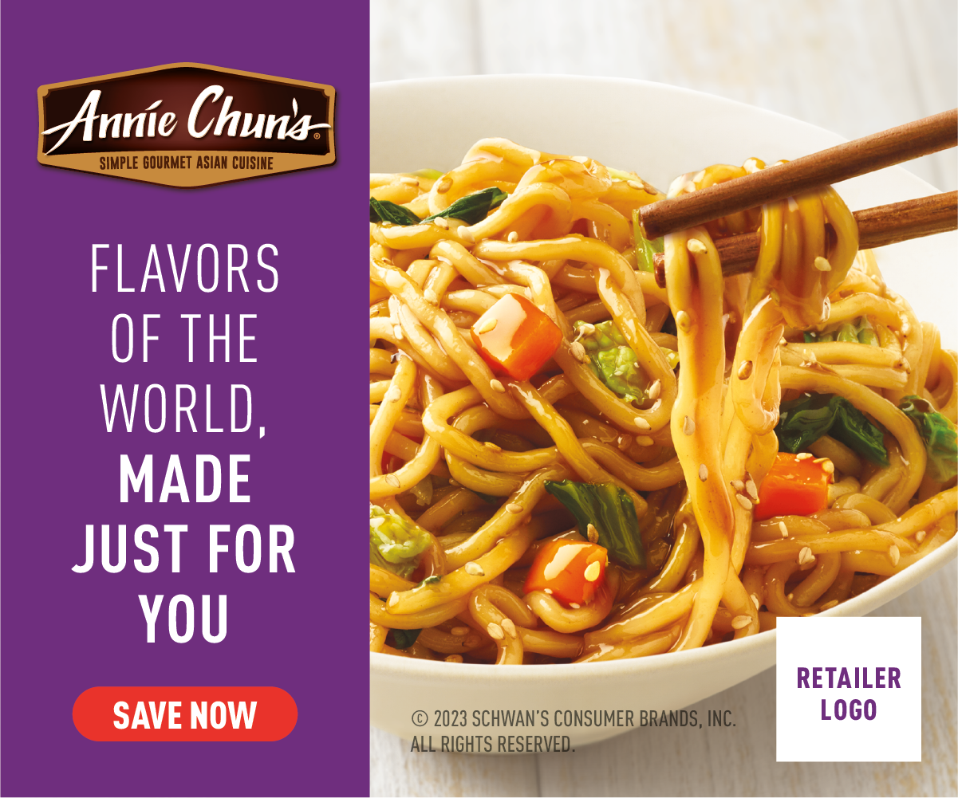
DIGITAL CTA OPTIONS
LEARN MORE, SHOP NOW OR SAVE NOW CTA OPTIONS:
Link to the product page on the retailer’s website for product information (CTA: LEARN MORE).
Link to the product page on the retailer’s website to add to cart if this capability is available (CTA: SHOP NOW).
Link to a coupon or offer (CTA: SAVE NOW).
300 x 250 pixels
Learn more
300 x 250 pixels
Shop now
300 x 250 pixels
Save now
ANNIE CHUN'S ® SOUP BOWL NOODLE BOWL

Slide 7
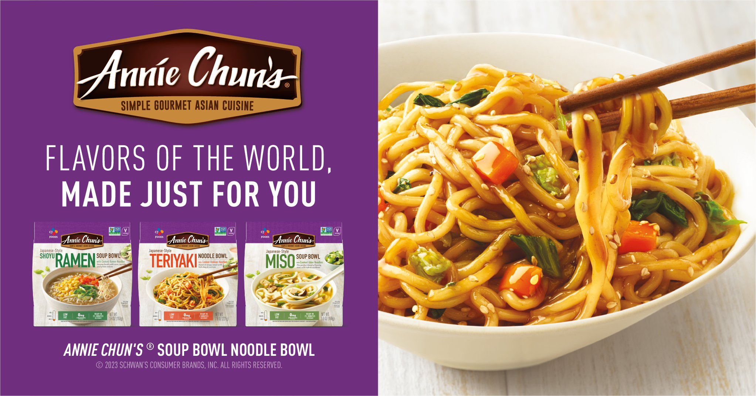
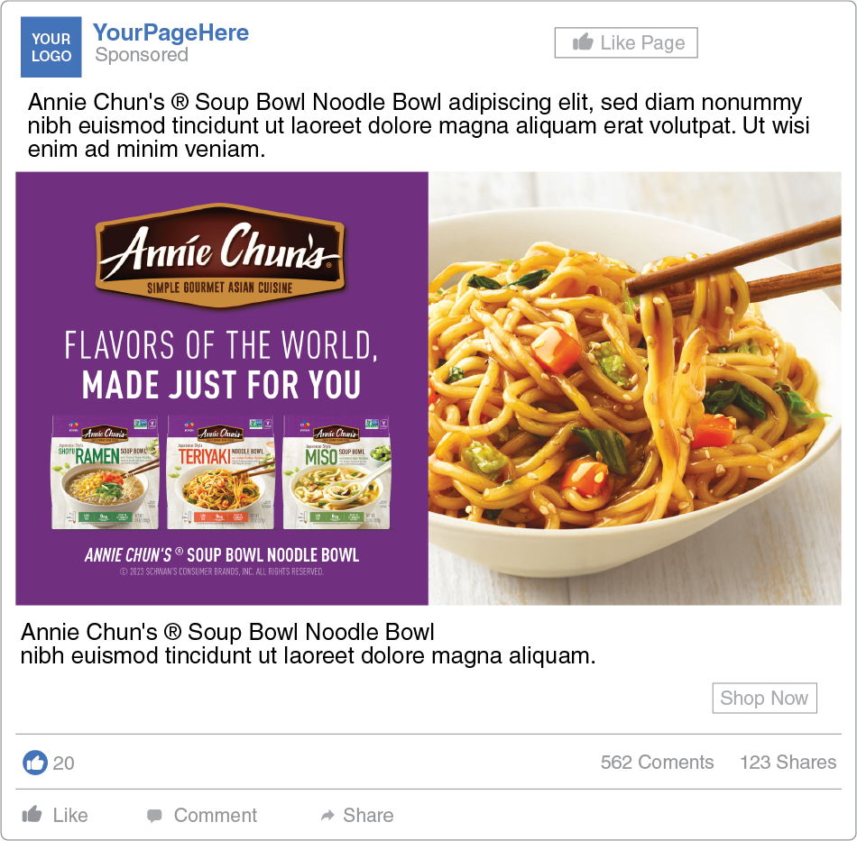
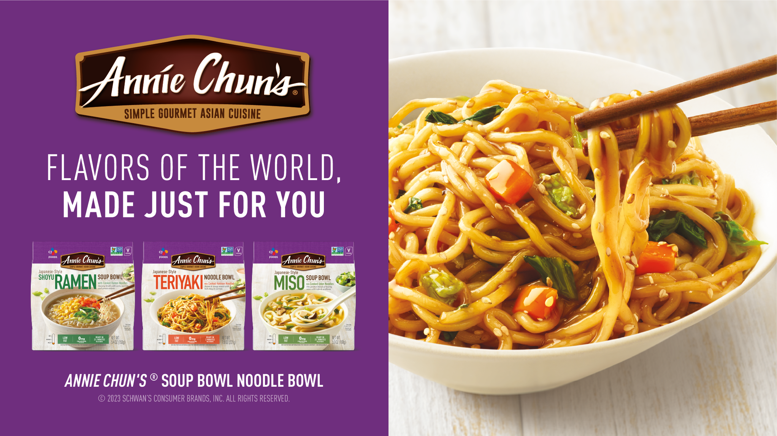
SOCIAL MEDIA
1,200 x 628 pixels
1,080 x 1,080 pixels
800 x 320 pixels
FACEBOOK:
1,200 X 628 PIXELS
INSTAGRAM:
SOCIAL POST COPY OPTIONS
1,200 X 628 PIXELS
Craving for a taste adventure? Look no further! Annie Chun's fully cooked noodle bowl will transport your taste buds to new heights with its authentic flavors.
TWITTER:
800 X 320 PIXELS
PLEASE NOTE: LAYERED PHOTOSHOP FILES FOR EACH SIZE CONTAIN LAYERS
FOR PACKS & HERO MELT IMAGE THAT CAN BE SWAPPED OUT.
ANNIE CHUN'S ® SOUP BOWL NOODLE BOWL

